Slide 1
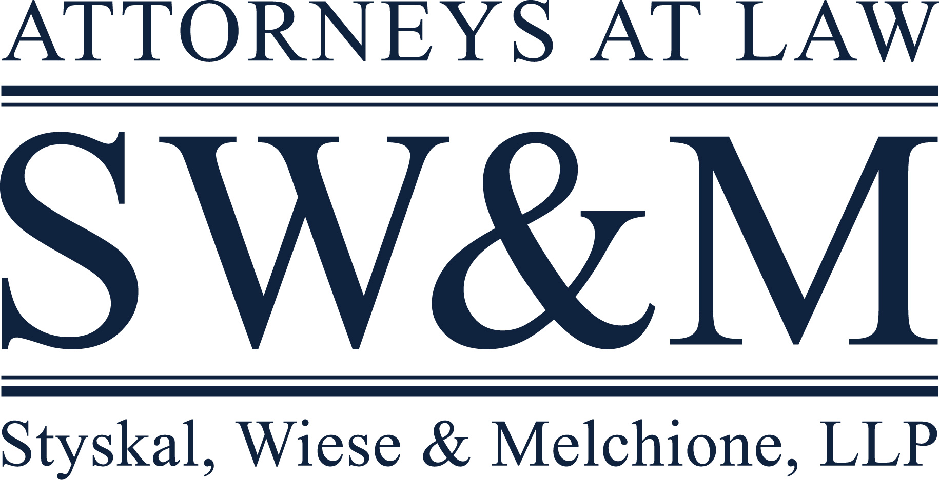
Risk Avoidance and Mitigation in the Collections Department October 30, 2020 Las Vegas, NV
Presented by:
Bruce A. Pearson, Senior Partner

Slide 2
Disclaimer
These materials were prepared by the attorneys of Styskal, Wiese & Melchione, LLP. Although this presentation was prepared with care, it is not designed to be a complete or definitive analysis of the law in this area. This presentation was prepared with the understanding that it reflects the authors’ perception of the state of the law as of the submission date to the conference organizer. Furthermore, the information contained in this presentation is not intended to constitute and should not be received as, legal advice and does not in any way create an attorney-client relationship.
If you have any questions, or require further information on these materials, please do not hesitate to call our office at: (818) 241-0103.

Slide 3
Deep Thoughts on the Collections Department
Perception: The redheaded stepchild of the Credit Union
Viewed as an expense center
Success is measured differently (unfairly)
Reality: Hard working, tech savvy, sophisticated folks who will make or break the CU

Slide 4
You are the Last Line of Defense
Will see “issues” from other departments
Disclosures
Loan underwriting & servicing
Deposit services
Possible employee fraud
Can avert common mistakes made by other FI collections professionals
May be able to keep the member/borrower away from the plaintiffs’ lawyers
Insurance coverage is limited for most lawsuits and direct losses

Slide 5
Focus on Current Class Action Topics
Insurance
Force placed coverage
Flood
Auto
GAP
Outsourced collections

Slide 6
Focus on Current Class Action Topics (cont.)
Fees/Rates
Overdraft fees and practices
Repeat NSF fees
Negative balance fees
“Foreign” ATM balance inquiry fee

Slide 7
Focus on Current Class Action Topics (cont.)
Disclosures
Spanish language
Credit card purchases finance charges
Call recording
No disclosure
TCPA
Robocalls

Slide 8
Focus on Current Class Action Topics (cont.)
Bankruptcy
Incorrect reporting of discharged debt
FCRA/state laws
Double use of credit report
Paid off loan reporting
Late reconveyances/titles

Slide 9
Focus on Current Class Action Topics (cont.)
Payments
Pay-to-pay fees
Pre-authorized 3rd party recurring debits
Repossessions
Notice of Intent forms
EFTA Opt In

Slide 10
Focus on Non-Class Action Threats
Cannabis Related Business (CRB) deposit accounts
Don’t ask/Don’t tell approach
Disguised as
Cash based business account – car wash, dry cleaners
Personal account – owners
CRB employee account
Risks
Lack of monitoring – Cole memo risks
Reward vs risk – No CRB account fees charged

Slide 11
Focus on Non-Class Action Threats (cont.)
CRB loans
Loan type and terms affects risk
Secured vs unsecured
Consumer vs commercial
Direct vs participation purchase
Owner occupied vs single tenant vs multi-tenant
Collateral seizure risk – RICO
“Innocent lender” defense

Slide 12
Focus on Non-Class Action Threats (cont.)
Internal fraud/Policy violations
Who typically catches the fraudster/bad actor?
Internal audit
Close department co-worker
Collections dept personnel
Fake/Fraud loans
Bad underwriting/Policy violations
Dormant accounts

Slide 13
What Will the Next Big Thing be?
Use of regulator complaint process
CFPB database – often “inspires” the plaintiffs’ bar
TD Bank consent order
CA regulator= new “mini” CFPB?
Privacy
Data breaches
CCPA violations
Class action suits are starting already
And CCPA 2.0 is coming

Slide 14
What Will the Next Big Thing be? (cont.)
Variable rate loans
Index and adjustment errors
DACA
State law protected class

Slide 15
The Collection Department’s Critical Role
Think strategically not tactically
Collecting on a small debt may cause a legal tsunami
Look for fraud and risk beyond the task at hand
Disclosures wrong/don’t match processes
Last update?
Large fees charged on small $ courtesy pay transaction
Fraudulent/out of policy loans
Unusual account activity
Example: $100 foreign ATM charge

Slide 16
Class Actions
Understand how plaintiffs’ class action lawyers think/assess cases
Stay abreast of latest class action topics

Slide 17
Head off Problems Early
Decline to collect on “problem” files
Negative share balance accounts
Overdraft fees
NSF fees
Loan deficiency balances
Faulty NOIs
Forced placed insurance

Slide 18
Head off Problems Early (cont.)
Listen to members’ complaints
Whack job or legitimate beef?
Complaint relates to possible systemic issues?
Size up the complaining member
Protected class/Sympathetic plaintiff?
“Set up” transactions
Overdrafts
Repeat NSFs
Pre-authorized debits

Slide 19
Educate Your Bosses
Risk mitigation
Collections Department inclusion in new product development
Comprehensive internal control type policies
Duty to report unusual/suspected illegal activity or policy violation
Personal ethics and account maintenance
Insurance coverage limitations
Examples:
“Fees” exclusion
Prior dishonest acts condition

Slide 20
Educate Your Bosses (cont.)
Class action risks
The class action plaintiffs bar is gunning for you
And they could care less about your not-for-profit nature
The class action you avoid
It’s impossible to “value” it
Requires strategic approach
Insurance coverage is VERY limited
Even crazy ideas = class actions
Example: Failure to “zero out” credit report payment field on paid off loan
The blame game
No one has to do anything “wrong” for the CU to end up in a class action

Slide 21
THANK YOU!
QUESTIONS?
Contact Us:
Styskal, Wiese & Melchione, LLP
550 North Brand Boulevard, Suite 550
Glendale, CA 91203
(818) 241-0103
www.swmllp.com
bruce.pearson@swmllp.com

