Slide 1
Notes:
If you are into clouds – it’s the climate for you
Nothing ever really good comes generally comes from a town with the name pass in it…
But it was nice place to grow up…

Slide 2
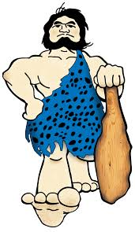
Notes:
Our highschool mascot was the caveman.
Founders great idea to inspire fear
1 of 3 other schools
PE, Home Econ, Art

Slide 3
Notes:
Attracted my father
Challenging time for Southern Oregon

Slide 4
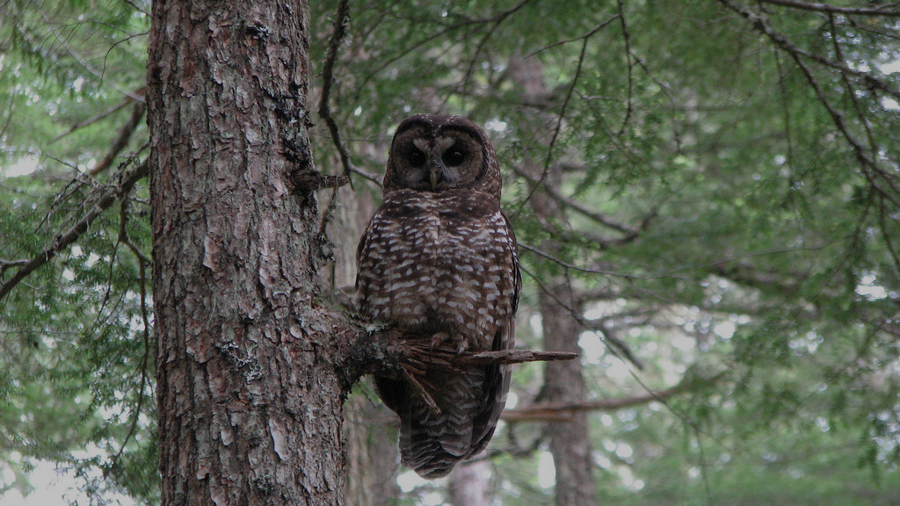
Notes:
1. Harry Potterville

Slide 5
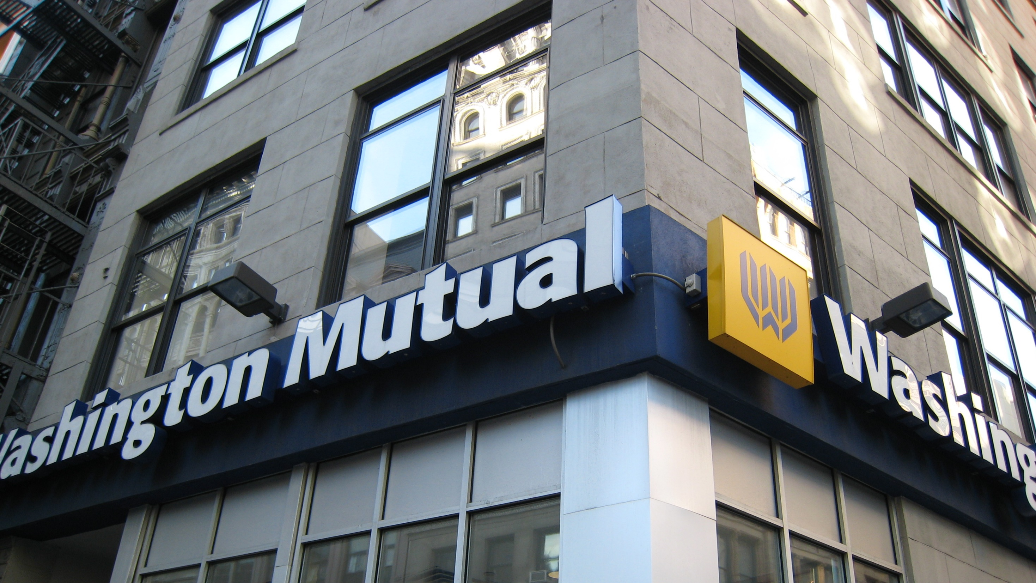
Notes:
I wanted to have a girlfriend and a social life.
Bank taught how bad CU’s were. (1. unregulated, 2. no-taxes, 3. our money smells better)

Slide 6
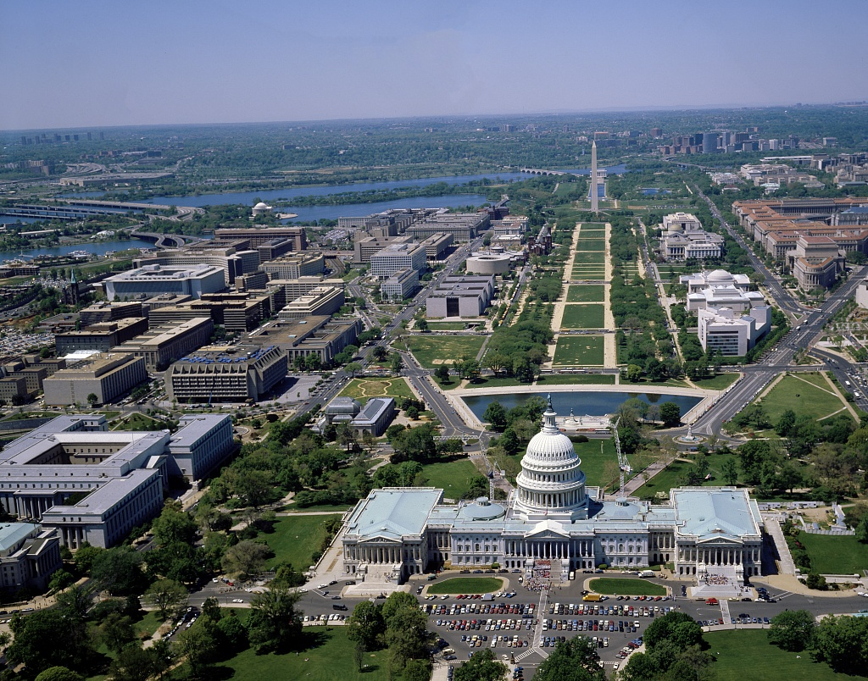
Notes:
Looking for a place to go to school – I picked another Neanderthal filled town
Get girlfriend.
Need job.
Banks won’t hire. Wrong phone number

Slide 8
CU2.0
Helping Credit Unions compete in the digital age
Notes:
My concerns…

Slide 9
Why
Constant Threat
Regulation
Fintech
Mergers
Digital
Service First
Notes:
1. NCUA is constantly increasing regulations. 2. Cyber Security constantly evolves 3. 1000’s of Fintech Startups 4. Baton is being merged on 5. Amazon, Netflix, - external factors 6. New generations prioritize digital and self service over traditional service. A

Slide 10
Why
Great.
Struggle.
Do what is right
Digital Engagement
Members first
Story Telling
Return value
Digital Trust
Great brands
Analytics

Slide 11
Industry Facts
40%
of members close new accounts in first 100 days
42.2
48
Membership is aging
1989
2014
1%
Biggest crisis since depression resulted
market share
8%
CU’s as an industry are sadly mostly irrelevant - 6000 cus
of the market

Slide 12
How do we change it?
87%
79%
SERVICE? Average Satisfaction is compared to banks at

Slide 13
How do we change it?
60%
30%
TRUST? of Credit Unions considered Trustworthy – Banks

Slide 14
How do we change it?
COOP = 30,000. Chase = 18,000.
Branches = Wells 6000+, Shared Branching = 5000+
CONVENIENCE?
ATMS
Notes:
Wells fargo joke about # of branches

Slide 15
How do we change it?
CU’s are 2.5% better, Credit Cards = 1.3% better,
Savings = .15% better, Mortgages are equal
BETTER RATES?
Car loans

Slide 16
How do we change it?
87%
SERVICE? Average Satisfaction is
60%
TRUST? of Credit Unions considered Trustworthy
CONVENIENCE?
ATMS
BETTER RATES?
Car loans
Conclusion: It isn’t about service, trust, convenience or rates…

Slide 17
What do members expect?
Your members expectations are not defined by banks!
Notes:
Great digital experiences
Recommendations
Accessibility
Service
Real-time Data to personalize

Slide 18
What do members expect?
1
2
3
4
5
6
Great digital experiences
Recommendations
Accessibility
Integrated Technology
Customization
Real-time
Your members expectations are not defined by banks!
Notes:
Best buy turned it around (amazon just partnered with them for an instore experience)

Slide 19
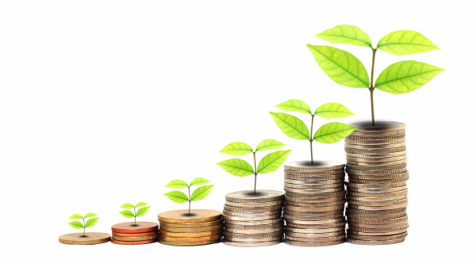
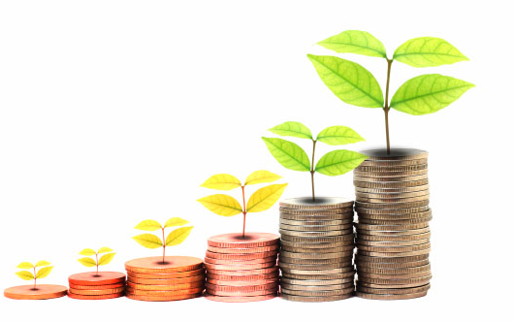
So What is a CU to do?
D
Differentiate
R
Repeat and Reinforce
E
Excite & Educate
A
Automate
M
Motivate
Notes:
6 Types of Data. Differentiation is the #1 thing you can do to personalize and make a connection with your members.

Slide 20
Differentiate
`
</>
Digital Analytics
=
Desire
Profitability
=
Fit
Wallet Share
=
Depth
Transaction
=
Triggers
Design Data
=
Product
Execution
=
ITTT
Notes:
6 types of data. Most CU’s use one – maybe two.

Slide 21
So What is a CU to do?
D
Differentiate
R
Repeat and Reinforce
E
Excite & Educate
A
Automate
M
Motivate

Slide 22
Repeat and Reinforce
Repeat
Reinforce
Create a unique and personalized member experience.
Use social media to digitally Reinforce decisions.
content
triggers
1
1
rewards

Slide 23
Notes:
This is my wife – I don’t know who’s kids these are

Slide 24
Notes:
Moved back to Oregon
Nobody died of Dysentary and no rattle snake bites

Slide 25
Notes:
1. Nothing good from a pass
2. Tuesday in Minnesota

Slide 26
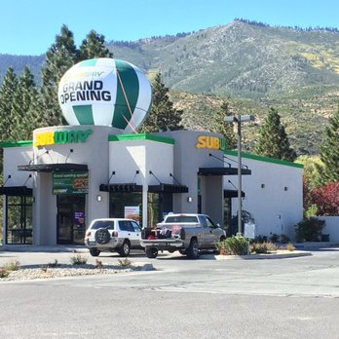
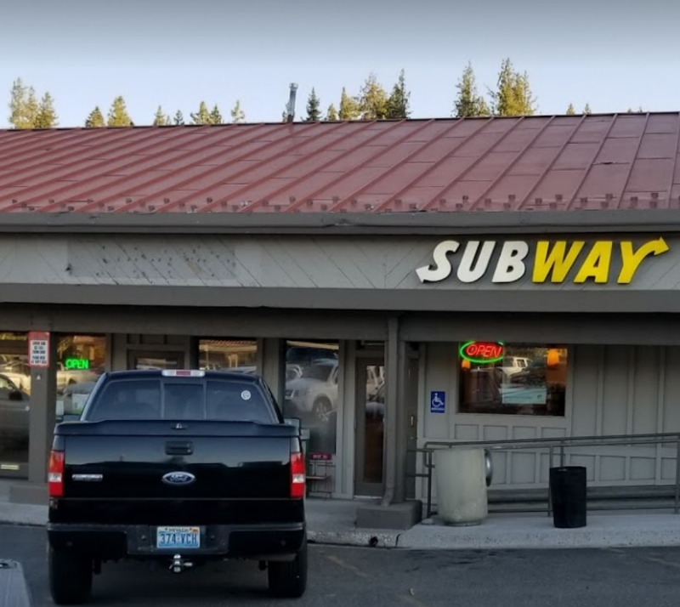
Which would you pick?
Notes:
1. Kids wanted lunch

Slide 27
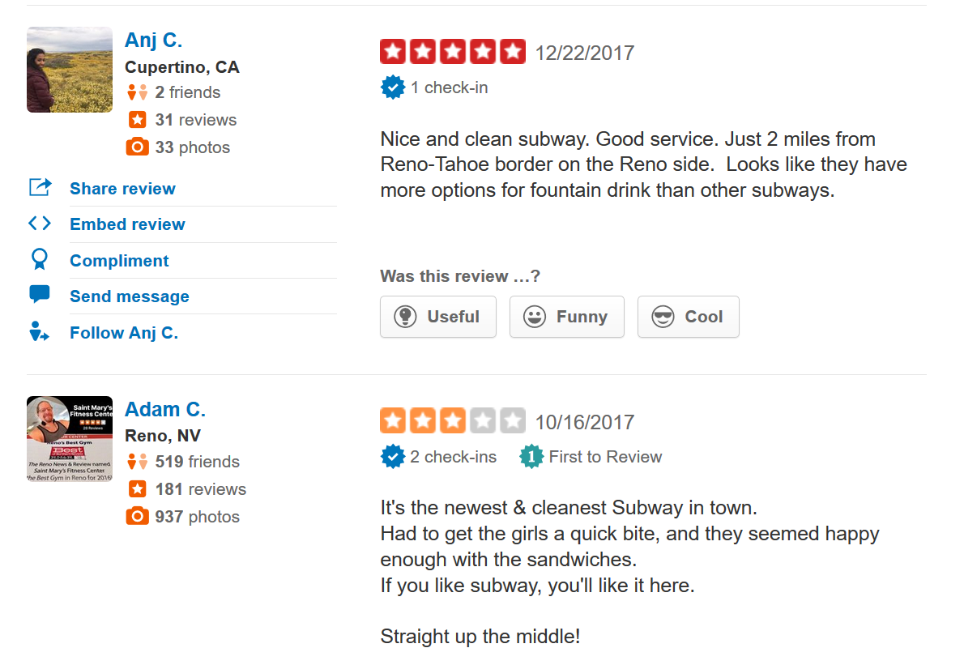

Slide 28
So What is a CU to do?
D
Differentiate
R
Repeat and Reinforce
E
Excite & Educate
A
Automate
M
Motivate

Slide 29
Excite
40%
of members close new accounts in first 100 days
Notes:
Give up during enrollment

Slide 30
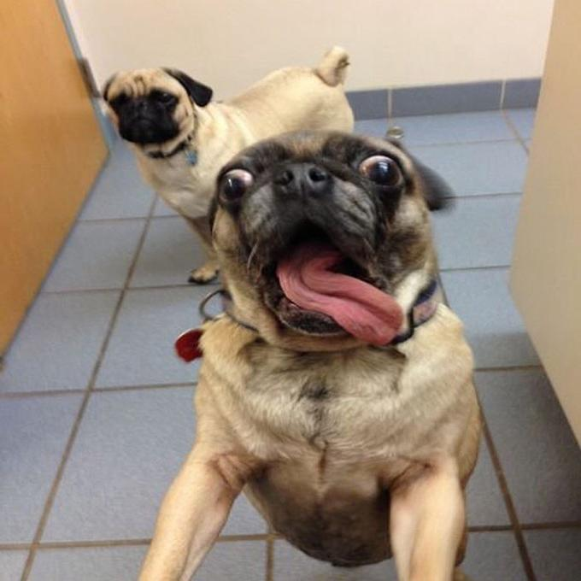
We are not delivering…
First 100 days
Notes:
Plan it out step by step
Incorporate surprise and delight
Personalize it.
Communicate phone, email, text, package, video, in person
Upsize it. 3 free atms – give them 4,
Go the extra mile.
Remove the friction

Slide 31
Notes:
What CEO of a bank wants you to tell them about your concerns…what banker is going to open that up – he’d be on the phone all day long…

Slide 32
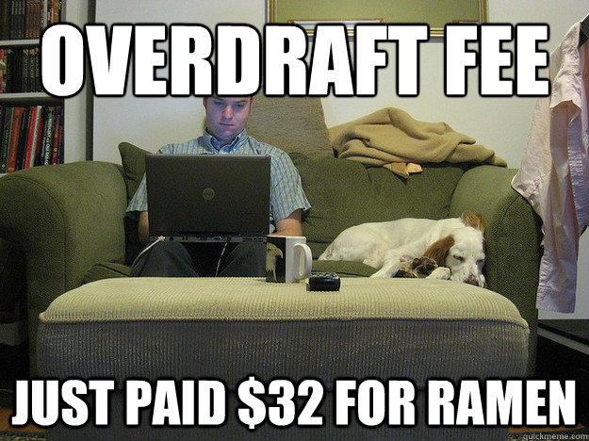
Notes:
How much more do you want to put him thru – the poor guy is already eating ramen

Slide 33
Educate
Buyer beware now
In all things
we trust
We don’t want to waste our time
seller beware
Members want to be knowledgeable
Notes:
The world has changed.
Teachers are the 3rd most trusted profession
Everyone wants to make good decisions
Story about mom -

Slide 34
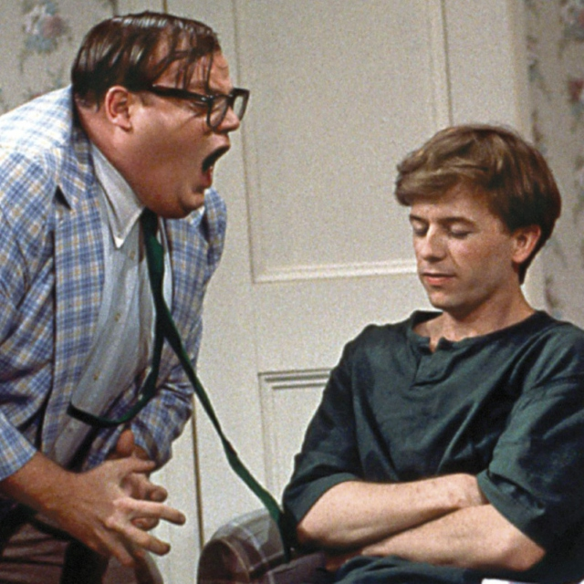
in a one to many approach
= Content Marketing
Educate
Videos
= Trust
= Sales
Blogs
FAQ
Notes:
Do what is right for your member.
Your members want a car- not a car loan
Your members want a vacation – not a credit card.

Slide 35
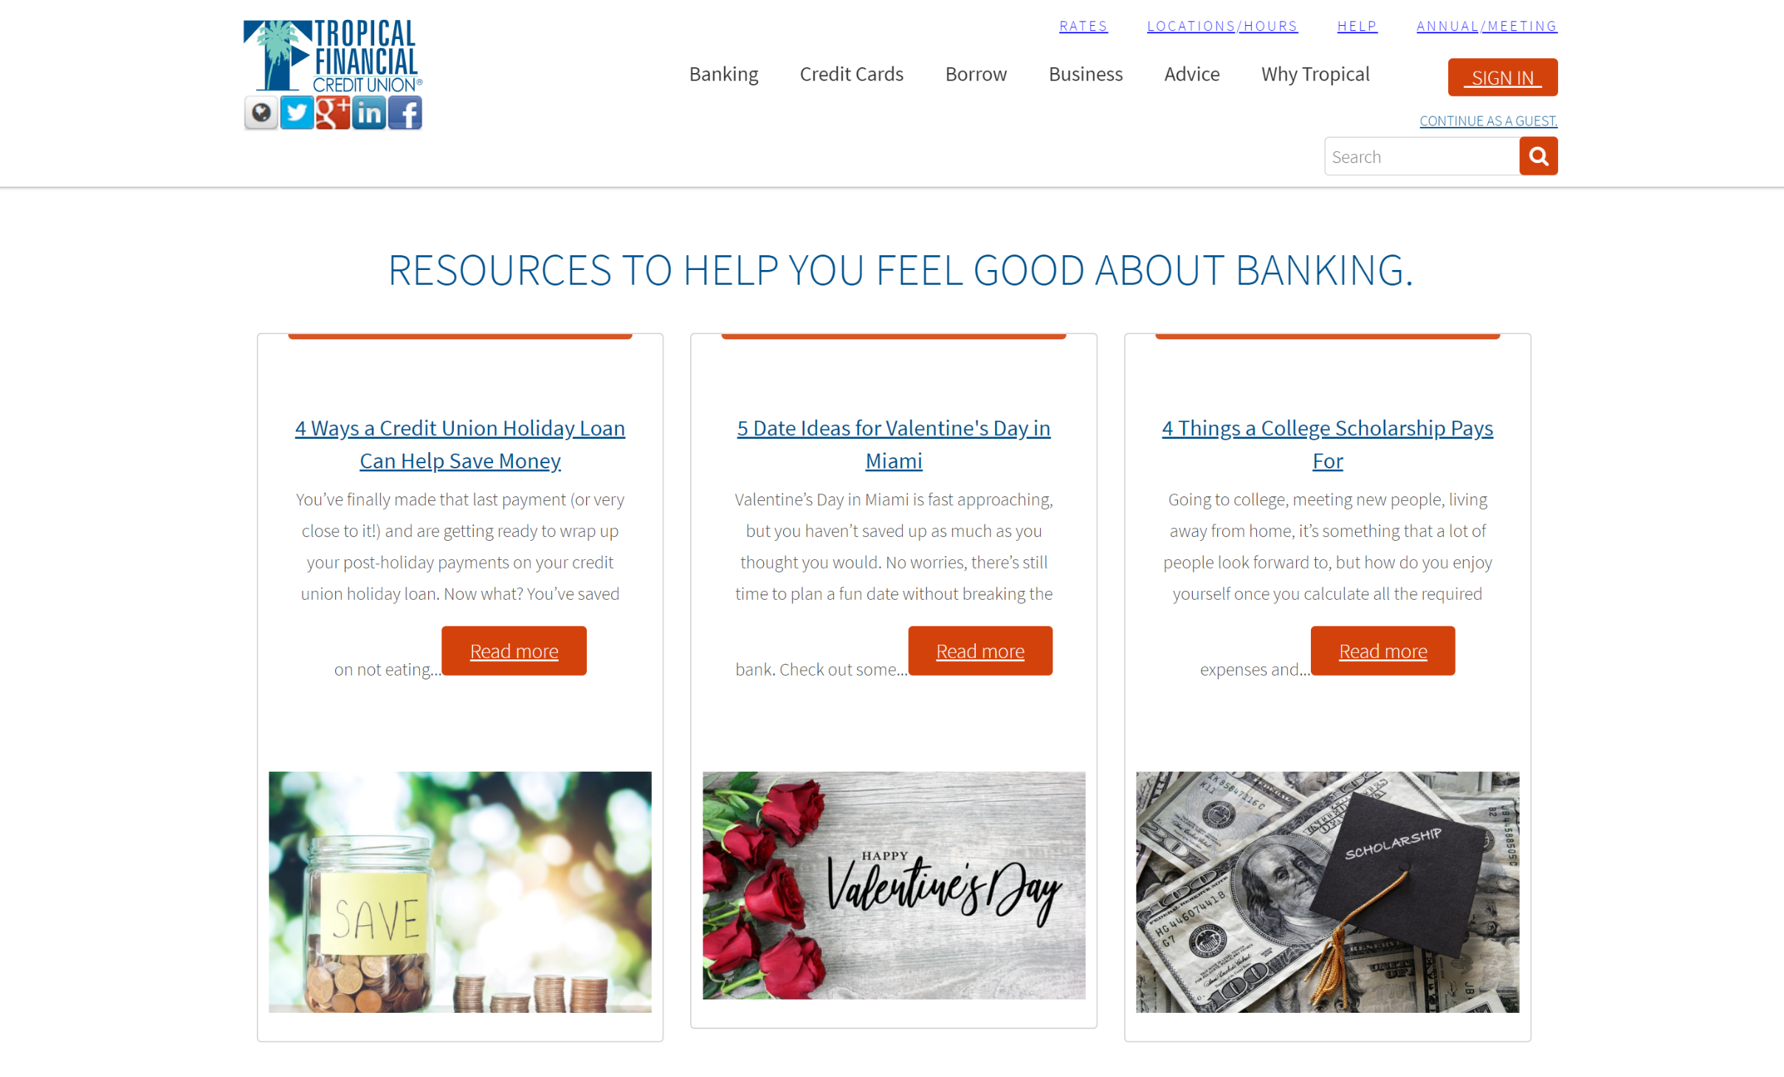
Notes:
642 in the first 3 months
Who wouldn’t go to their credit union for dating advice…

Slide 36
So What is a CU to do?
D
Differentiate
R
Repeat and Reinforce
E
Excite & Educate
A
Automate
M
Motivate
Notes:
Use technology to A) create self service B) engage the member C) make consistent D) do the dirty work (sales) E) share the info

Slide 37
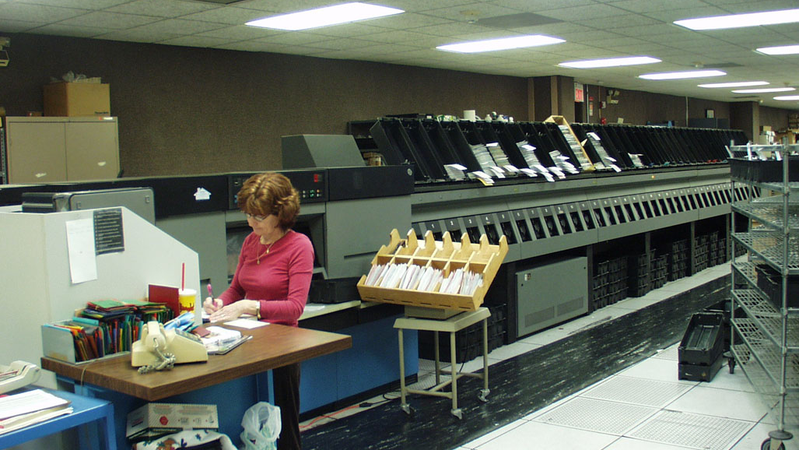
Notes:
This used to be the idea of automation…we get one big machine…but today’s thing – it is all about personalization

Slide 38
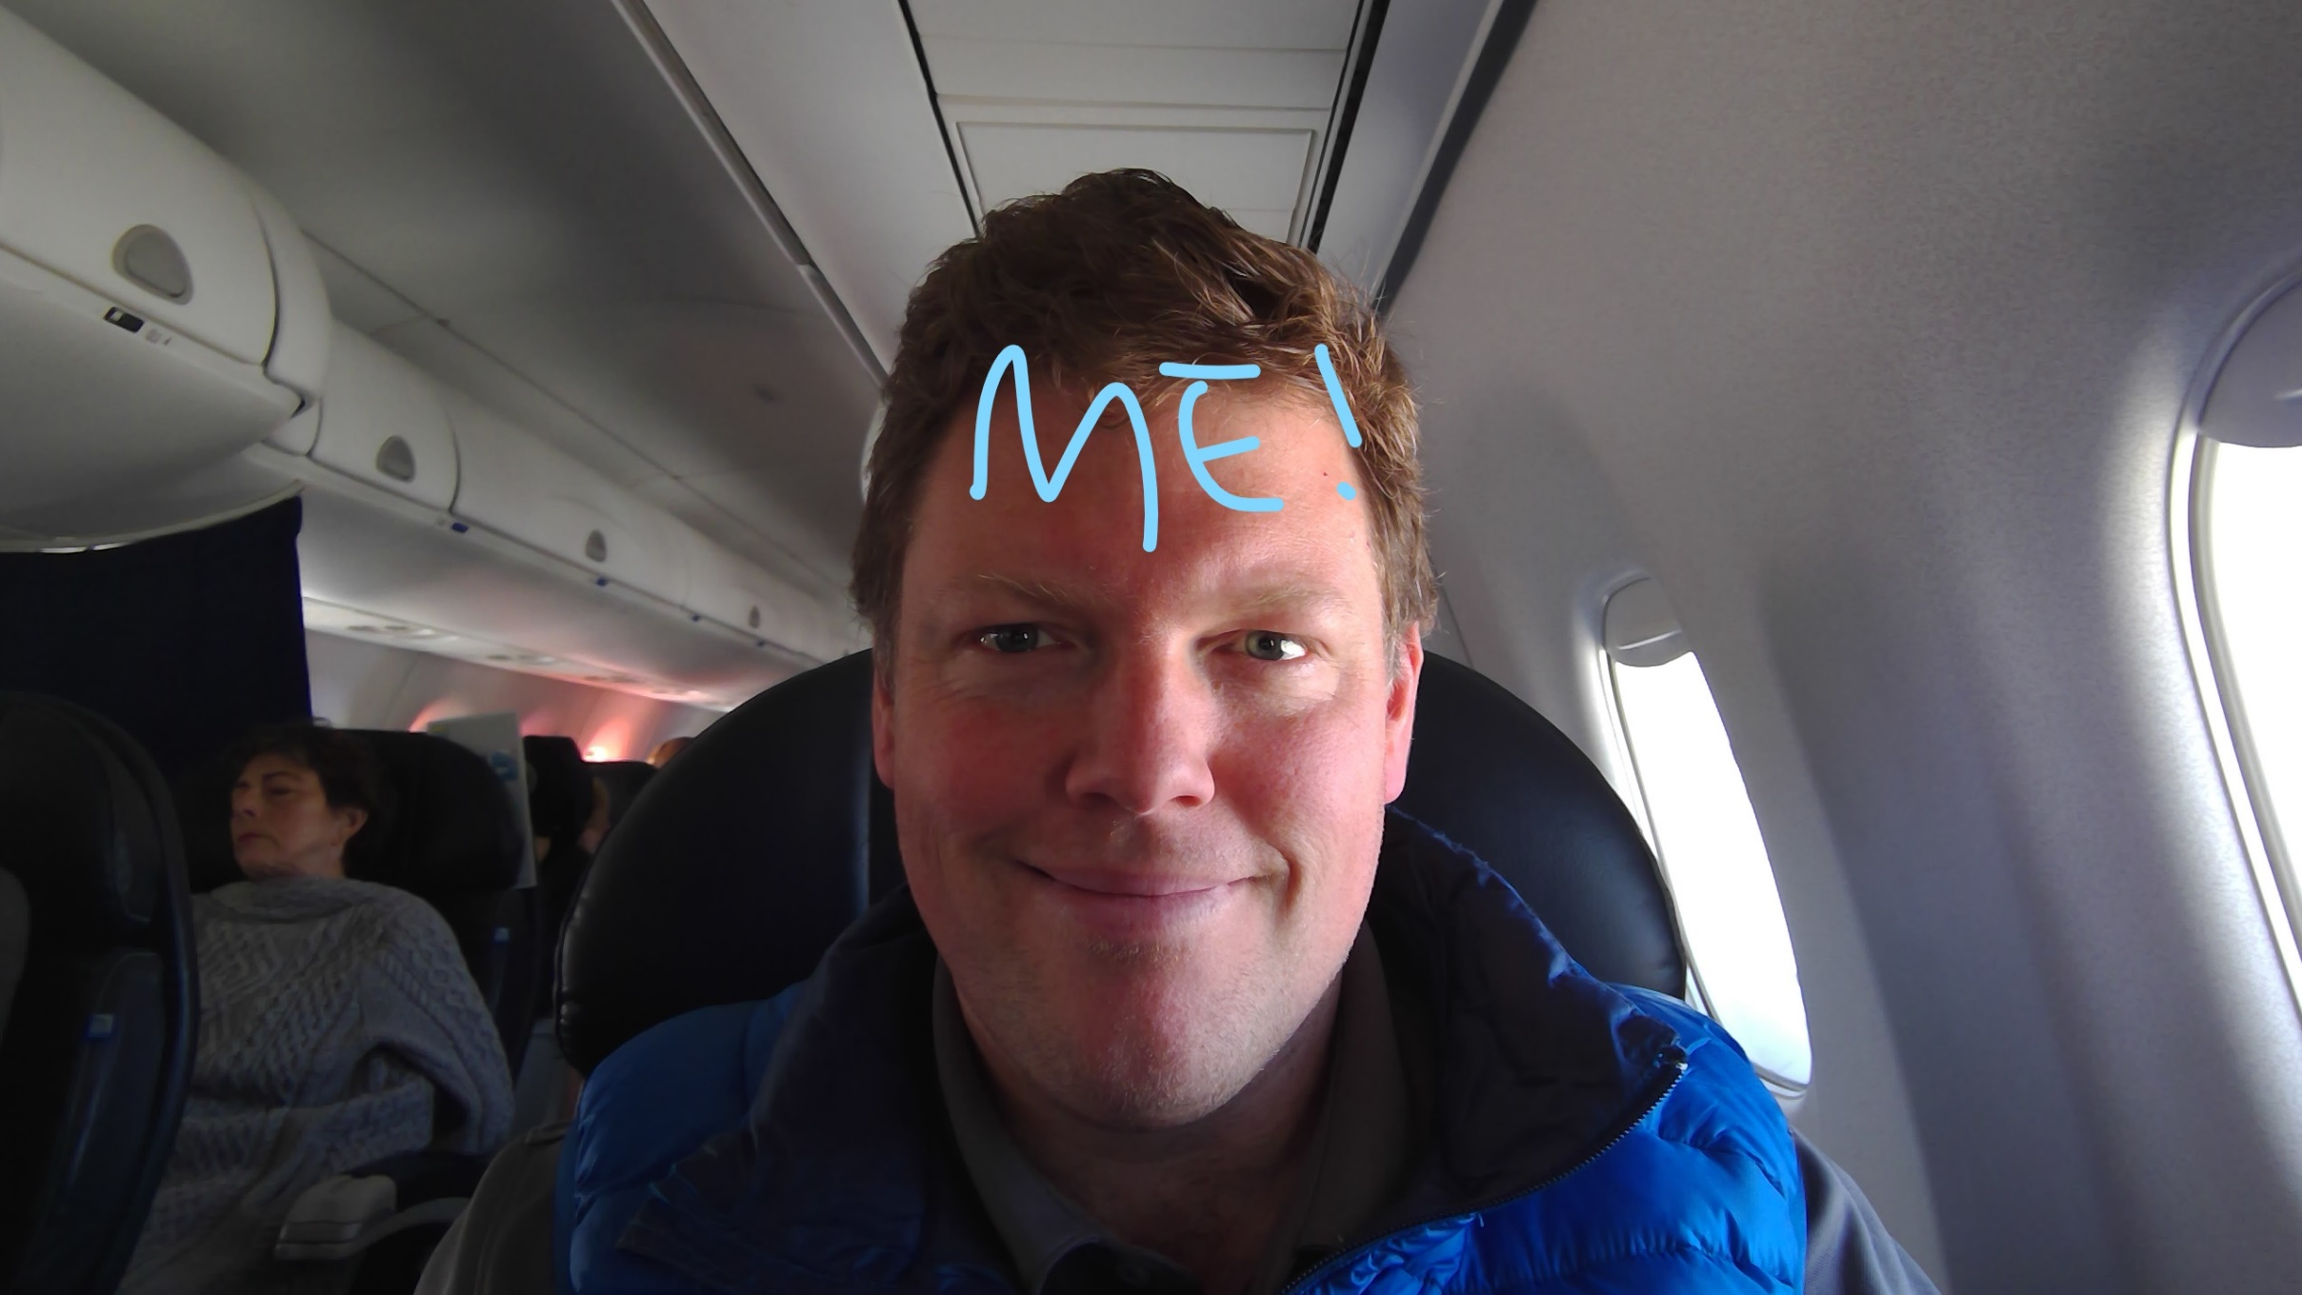

Slide 39
Automate
Marketing Automation
Online Banking
Self Service
CRM
Lending
Mobile Banking
Contact Center
ATMs
Branch
Mobile Wallet
Notes:
Every one of these channels should be able to use Differentiated data with educational content.

Slide 40
So What is a CU to do?
D
Differentiate
R
Repeat and Reinforce
E
Excite & Educate
A
Automate
M
Motivate

Slide 41
Motivate
REI Way | CU Version
Dividend back based on purchase value to buy more stuff | Patronage Dividend
Training and Trips (experiences) | Workshops and Experiences
Return Policies (return anything for any reason) | Fees, Rate Reset, Skip a Pay
Garage Sale (sell all of the return stuff at a twice year early morning event) | Financial Tune Ups, Special Refinance Sales, Special Investments, Member Car Sales
Make the member feel like they own the place | Make the member feel like they own the place
Notes:
The rei bucks – you can’t use them anywhere – I even tried them at subway. If someone is going to take REI Bucks – it should be the subway at Donners Pass.

Slide 42
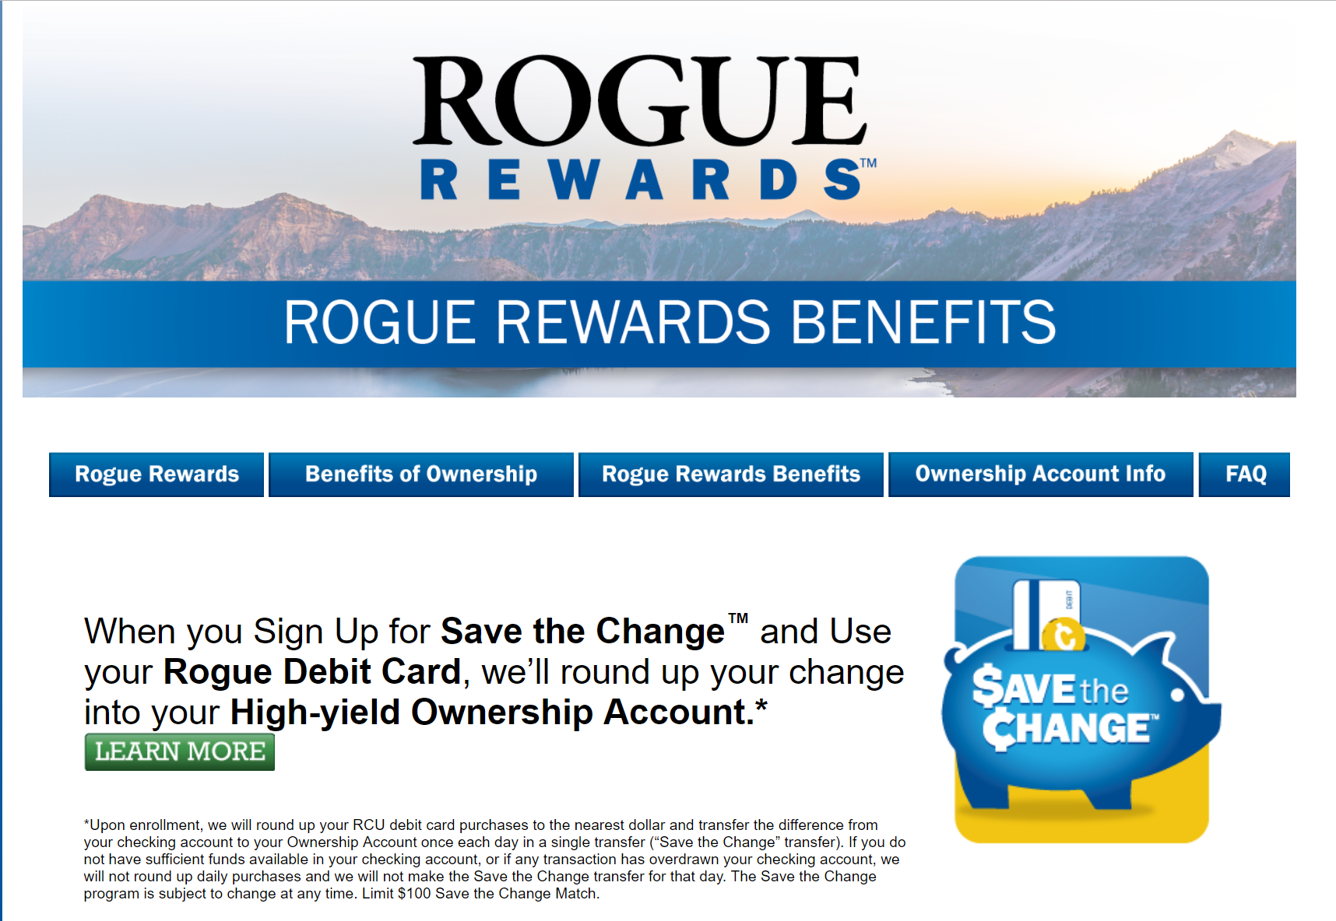

Slide 45
Notes:
The other side of a pass…fintech’s are coming…we have a lot of climbing. We didn’t necessarily chose to be here but we can chose to go forward…
Outsource something not core – Office 365
Get a blog tomorrow (we can help)
Track your digital engagement

Slide 46
Summary
D
Differentiate
R
Repeat and Reinforce
E
Excite & Educate
A
Automate
M
Motivate

Slide 47
Want to get started?
first10@cu-2.com
Get access to the first 10 ideas
to implement in your credit union tomorrow.
Join the FACEBOOK group
https://www.facebook.com/groups/creditunion2.0

Slide 48
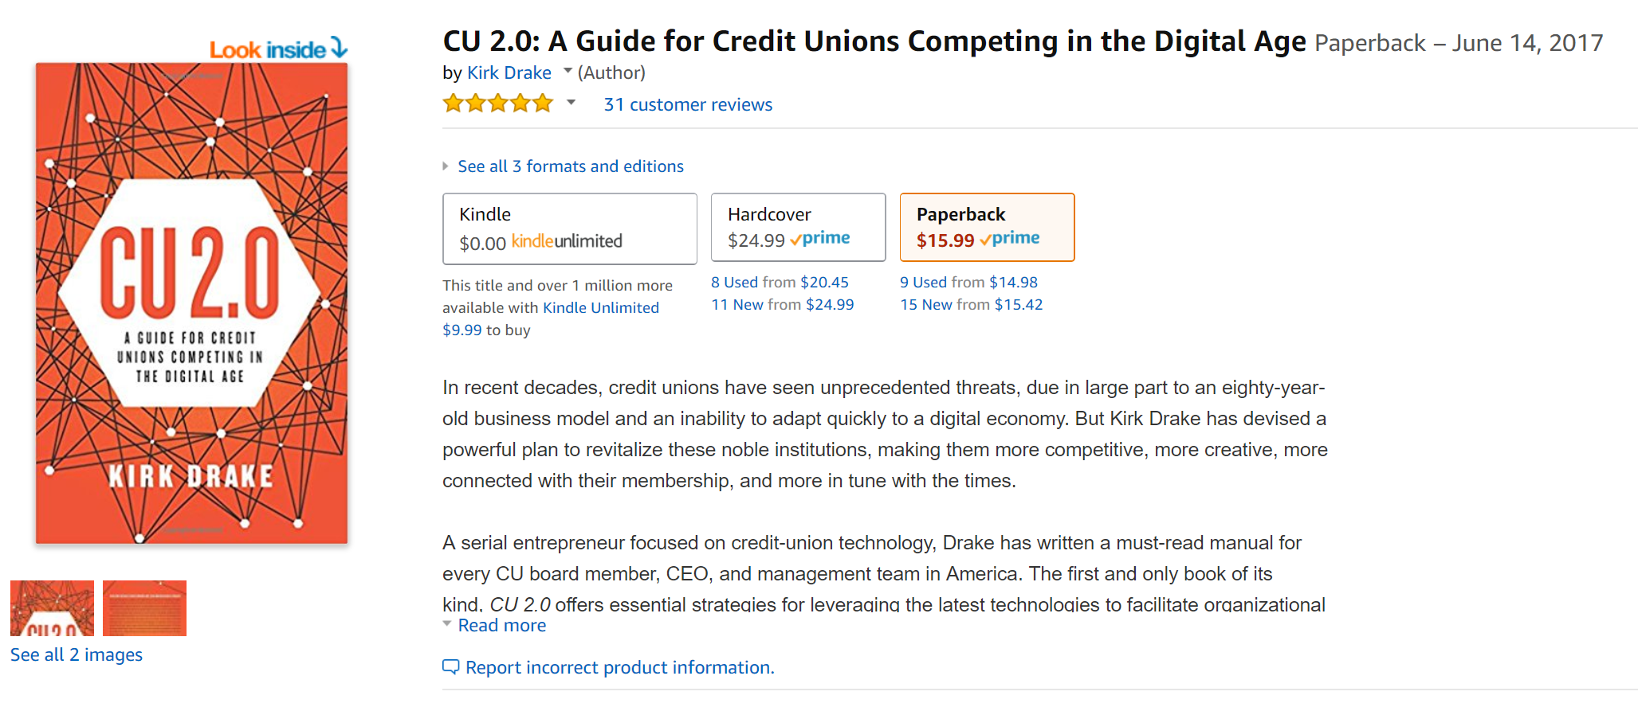
Contact Information
www.cu-2.com
kdrake@cu-2.com
facebook.com/groups/creditunion2.0
Notes:
Everyone enjoy lunch – let me know if you want a subway recommendation.

