Slide 1
NCUCA
Fraud and Risk Education
April 17, 2019

Slide 2
Reputation Risk:
This affects a financial institution’s ability to meet its business objectives and preserve its image and reputation.

Slide 3
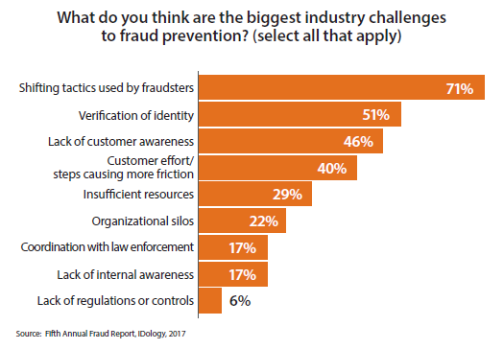
Fraud Prevention Challenges
3

Slide 4

WHAT KEEPS YOU AWAKE AT NIGHT…?

Slide 5
Top Fraud Risks in 2019
Internal Fraud
Non-EMV cards and ATMs
ATM jackpotting
ATM Cash Out
Synthetic ID theft
Phishing attacks
Authentication
Data breaches
Cyber break-ins
Card, ACH, A2A, P2P, mobile, online
Wire Fraud
Loans – consumer, credit card, HELOC, unsecured (charge-offs)
Check fraud – consumer, corporate/cashier/business
Business email/phone
Remote deposit capture
ADA website compliance
5

Slide 6
How the Bad Guys are Breaking In
Internal – employee within
Card or card number fraud
Phishing, email, text messaging or phone calls
Data breaches
System intrusions (includes third-parties)
Identity theft – real or synthetic
Authentication
Social media / network
New account fraud
Account takeover fraud
Mobile devices
Call Center
Third party
Loan fraud and collections
6

Slide 7

2019 Risk

Slide 9
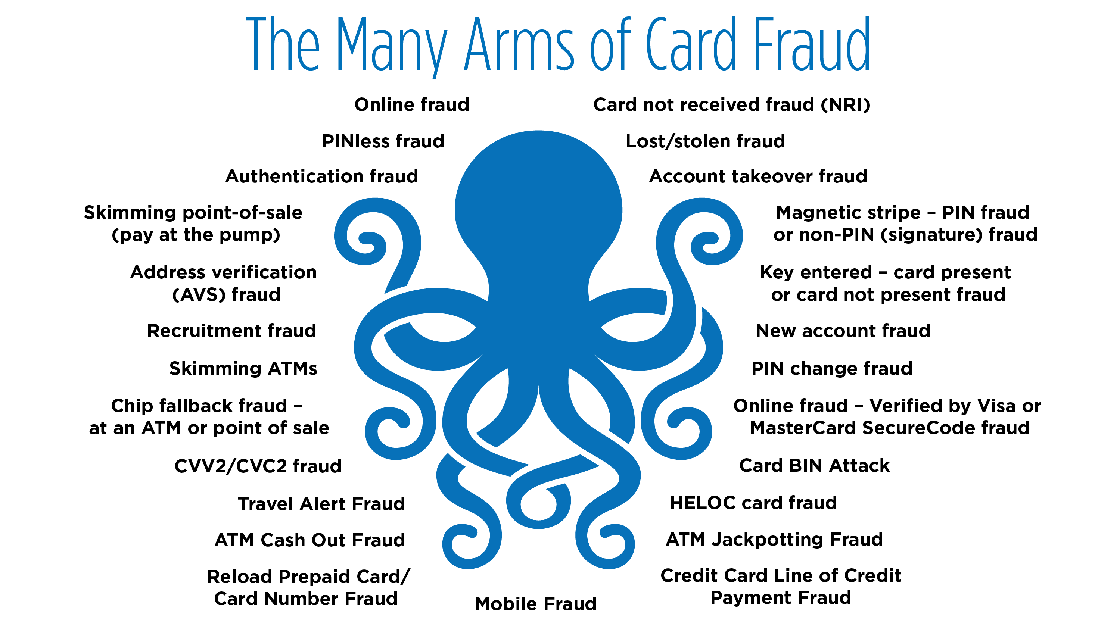

Slide 10
Internal Risk Exposure
Embezzlements continue to be a “sleeper” and it can happen to any credit union. It’s key to continue to perform internal and external audits to help find any unusual activity.
Key:
Segregation of duties across all products and services
Dual control for all products and services
Review of all employee accounts
10

Slide 11
Transaction Fraud
Wire Fraud
Person calls up the call center or 3rd party call center and request an internal transfer from the HELOC to their share/share draft account. Funds leave using a check , cash shared branching or an outgoing wire and the bad guy passes all of the authentication measures
Paper Check Fraud
Bad guy creates counterfeit CU official checks and the checks clear the risk mitigation measures
Mitigation: Contact the member using multiple layers of risk mitigation would have mitigated the exposure
Mitigation: Positive pay/payee positive pay would have prevented the exposure
11

Slide 12
Transaction Fraud
Payment Card Fraud (debit and credit)
Bad guy obtains card information from a data breach and creates either a “card present” or “card not present” fraud
ACH Fraud
Bad guy obtains routing and account number, breaks into the credit union, using online or bill pay systems and sends an ACH credit to the RDFI and then hires money mules to withdraw the funds. ACH debits are pulled from the RDFI and brought into the ODFI.
Mitigation: Multiple layers of card security may have reduced the fraud exposure. Daily $ limits is a key risk mitigation measure.
Mitigation: Performing multiple layers of authentication by the originating depository financial institution (ODFI) prior to the ACH credit going out the door may have prevented the exposure. ACH debit payments on credit card and HELOC may increase the risk if the ACH payment is returned by the RDFI.
12

Slide 13
ID Theft – What Types of ID Theft Are Happening?
Synthetic ID Theft
  A fabricated Individual who “does not exist”. A fraudster creates a “synthetic” identity that combines fabricated information with stolen consumer information, such as names, birthdays, Social Security numbers and/or addresses.
Stolen ID Theft
  A real individual who “does exist”. A fraudster steals the real individuals information and takes over the real persons identify in the event to commit ID fraud.

Slide 14
Credit Reports – Free Freeze to Prevent ID Theft
September 21, 2018 – Free Freeze
Experian
Employee and Member Education is Key!
Equifax
TransUnion
Every consumer, young or old should place a “free freeze” with each credit bureau.
Consumer is the only one that can place the “free freeze” and the consumer is the only one that can remove the “free freeze”.
14

Slide 15
Authentication Layers – Key Risk Measure
Authentication layers are key today to validate your “new member” and your “existing member”.
If a New Account and Account Takeover gets through your “authentication” layers, financial damage is ahead.
Are you tracking where the new account or account takeover broke through the authentication layers?
Are you tracking synthetic of stolen ID fraud as a result of:
  loan fraud and collections and;
  1st payment is not made and insurance is not in force.
Indirect lending agreement – Does it include the return of the loan if it’s the result of ID theft – stolen or authentic?

Slide 16
Risk Mitigation to Share with Members
Closely monitor all credit accounts and loans, to catch and report any suspicious activity on any one of those accounts
Immediately report any suspicious credit or loan account activity – no matter how remote the suspicion to the credit union
Create a password/passcode on your account
Set lower daily dollar limits on your accounts
Watch your transaction activity daily
Sign up for alert notifications on your card transactions and any other account transactions if available
Sign up for the fraud alerting services offered by the three credit bureaus to receive notifications about potentially fraudulent activity
Sign up for free credit monitoring services, to monitor and report unauthorized activity
16

Slide 17
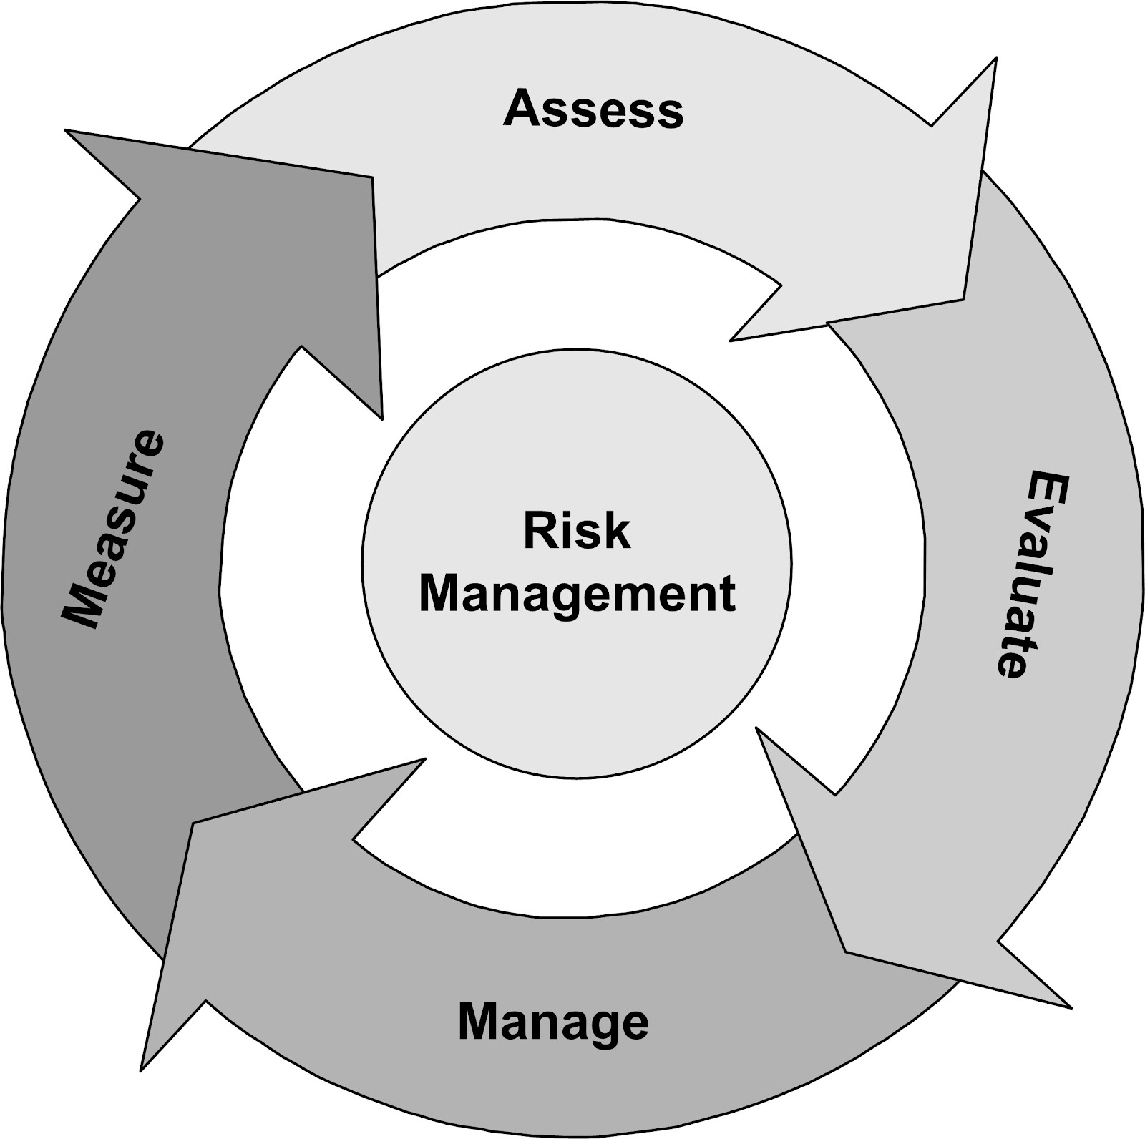
Best Practice Fraud Strategies
Well developed and integrated risk management
Balance appetite for risk
Evaluate the threat landscape to prioritize a treatment strategy
Don’t buy into a “one-size fits all” approach to security
Commitment to make tough choices
Forward looking strategy
17

Slide 18
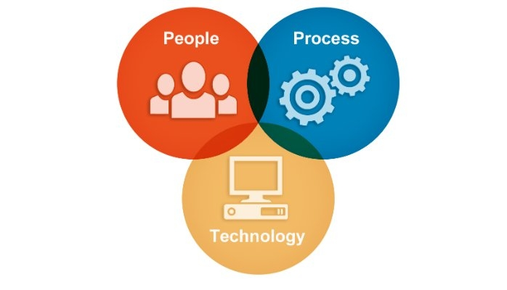
Best Practice Fraud Strategies
18

Slide 19
Fraud Mitigation Strategies are Key!
Education, Education, Education – consumers and staff
Enterprise risk management strategies – big picture view
Continue to monitor all accounts across all types of activity
If you suspect an attack, act fast
Balance consumer service with risk appetite
Authentication layers is a must
Invest in technology
Work together with risk-conscious vendors
Don’t let your guard down, stay tuned in
19

Slide 20
Time for Questions
Ann D. Davidson
Vice President of Risk Consulting
608.250.9617
ann.davidson@alliedsolutions.net
20

Slide 21

We look forward to helping you grow, protect and evolve.
alliedsolutions.net
800.826.9384
© 2018 Allied Solutions, LLC. This communication is proprietary
and confidential and is provided for informational purposes only. You are
prohibited from disclosing this communication to any third party or using it
for any purpose without the express written consent of Allied Solutions, LLC.

