Slide 1
Industry Update
National Credit Union
Collections Alliance 2018
Bill Cheney, President/CEO
SchoolsFirst Federal Credit Union
bcheney@schoolsfirstfcu.org

Slide 2
Agenda
Credit union growth and benefits
Credit union impact
Update on the economy
Consumers
Credit union operating results
Regulatory burden

Slide 3
SchoolsFirst Federal Credit Union
800,000 Members
$14.3 billion in Assets
Serving School Employees and their family members since 1934
48 branches in Southern California
1,800 teammembers
Headquartered in Santa Ana, California

Slide 6
Credit Union Growth & Benefits
Notes:
Mike

Slide 7
$14.2 BILLION!

Slide 8
$10.2 Billion!

Slide 9
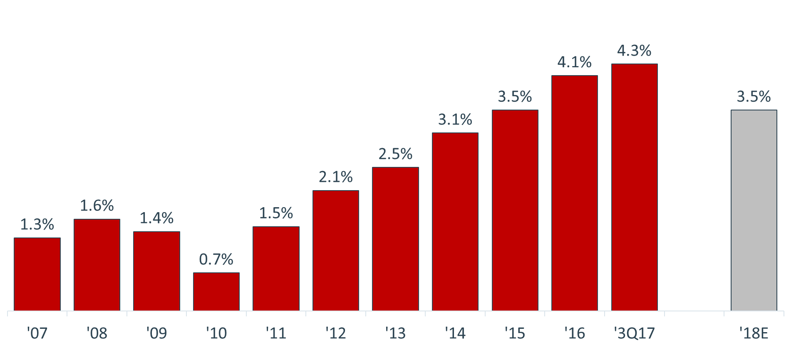
Consumers Voting with their Feet!
12-Month Growth in CU Memberships
(Source: NCUA and CUNA)

Slide 10
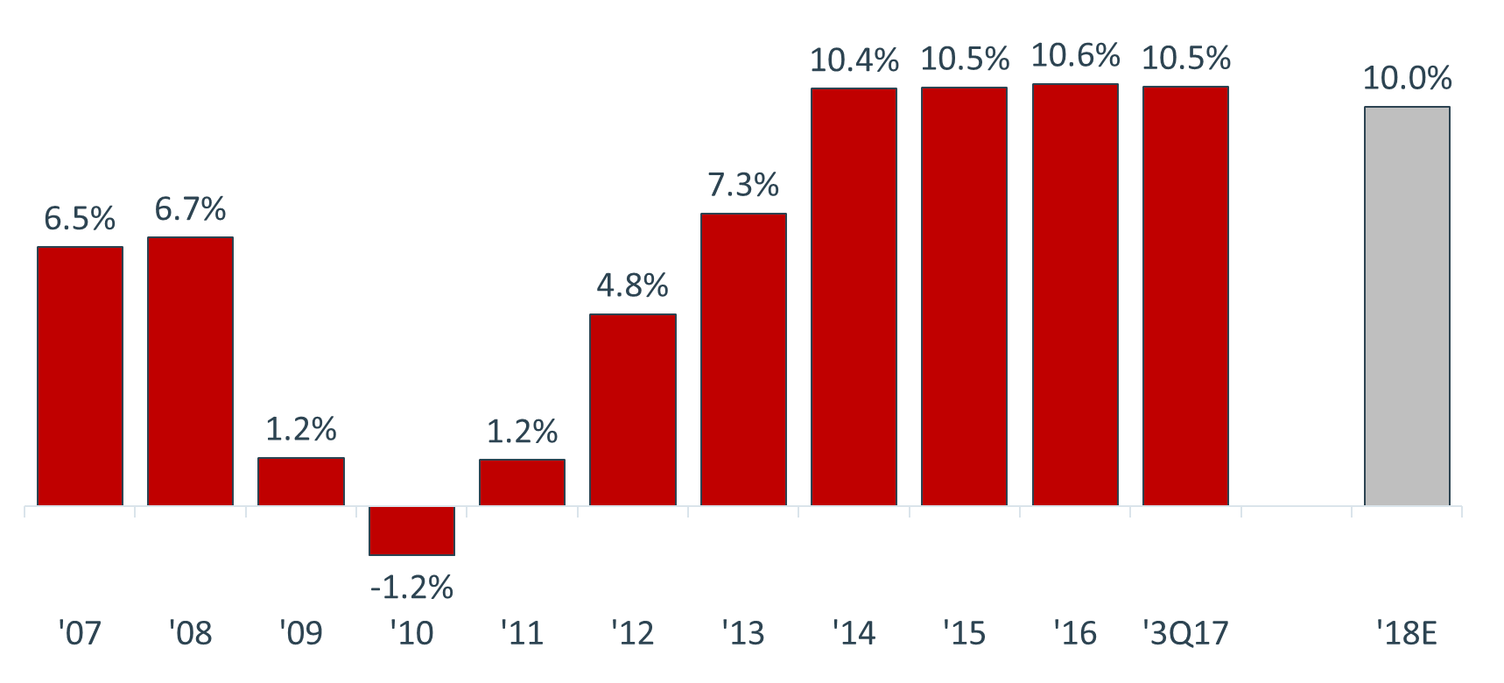
Obvious Meaningful Interactions!
12-Month Growth in CU Loans
(Source: NCUA and CUNA)

Slide 11
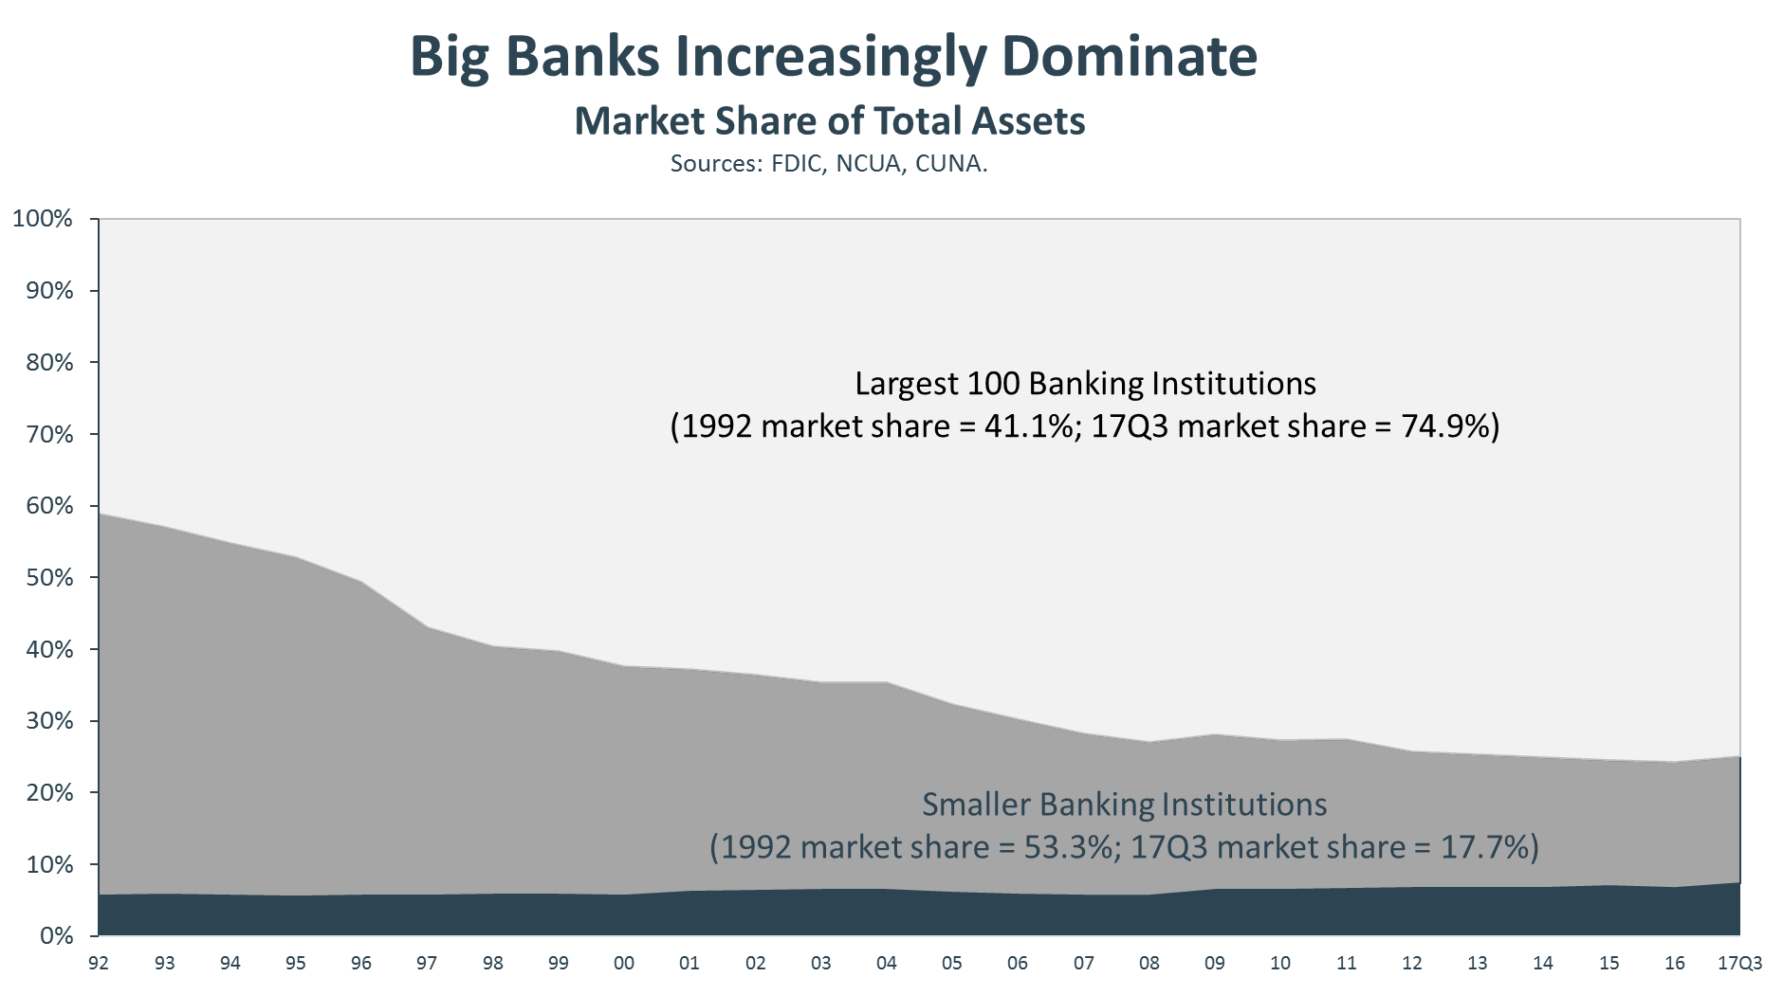

Slide 12
Helping Average Americans
Family Net Worth
Source: Federal Reserve and CUNA.

Slide 13
Credit Union Impact
Notes:
Jordan:
- Use IMPLAN’s economic modeling program, a standard approach to measure regional economic impacts used by universities and local governments across the U.S.
- The method allows us to look at the total size of the credit union industry as well as estimate the increase in demand that credit unions stimulate throughout the economy.

Slide 14
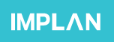
Indirect Effects
Induced Effects
Total Impact
Direct Effects
Notes:
The model takes into account three mains sources of impact on the economy:
Direct effects: the jobs, salaries and operating expenses at credit unions, and give us an idea as to the size of the industry.
Indirect effects: the increased demand from the purchase of intermediate goods and services by credit unions—for example, credit unions purchase office supplies and contract janitors and IT staff, increasing demand for these products and services in the economy.
Induced effects: the household spending by credit union employees and other workers in the economy that benefit from the increased demand, such as purchases of groceries, real estate and vehicles.

Slide 15
Purchase of Intermediate Goods & Services
Household Spending
Total Impact
Jobs, Earnings, Operating Expenses
Notes:
The model takes into account three mains sources of impact on the economy:
Direct effects: the jobs, salaries and operating expenses at credit unions and give us an idea as to the size of the industry.
Indirect effects: the increased demand from the purchase of intermediate goods and services by credit unions—for example, credit unions purchase office supplies and contract janitors and IT staff, increasing demand for these products and services in the economy.
Induced effects: the household spending by credit union employees and other workers in the economy that benefit from the increased demand, such as purchases of groceries, real estate and vehicles.

Slide 16
253k jobs
335k jobs
883k jobs
295k jobs
Notes:
- There are roughly 295,000 full-time equivalent credit union employees,
- This results in an additional 588,000 indirect and induced jobs, for a total of 883,000 jobs, or roughly the population of South Dakota.

Slide 17
$43b
$56b
$192b
$93b
Notes:
- In dollar terms, the direct effects of the credit union salaries and operating expenses add to $93 billion in direct output.
- This generates an additional $99 billion of indirect and induced effects, for a total estimated economic impact of $192 billion on the U.S. economy.
- Of this, $117 billion is ‘value added’, which can be thought of as the estimated increase in economic activity—like wages or business profits—that results from the presence of credit unions.

Slide 18
Economic Impact
883,000 jobs.
$192 billion in economic output.
$117 billion in value added.
Roughly the GDP of Nebraska.
Bigger than GDP of 132 countries, including Ukraine, Ecuador and Kenya.
Notes:
-$117 billion of the $192 billion is “value added”--which can be thought of as the estimated increase in economic activity—like wages or business profits—that results from the presence of credit unions.

Slide 19
Federal Tax Revenue
$3.0b
$3.5b
$10.7b
$4.2b
Notes:
- Do you ever hear people say that credit unions don’t pay taxes?
- Credit unions pay A LOT in taxes!
- This is the estimated tax revenue generated by the direct, indirect and induced effects.
- We can see that:
- Credit unions and their employees directly pay approximately $4.2 billion in federal taxes, including employer taxes, excise taxes, taxes on imports, and income taxes paid by credit union employees.
- There is another $6.5 billion in tax revenue generated through indirect and induced effects—
- $3.0 billion from taxes generated by credit union purchases and 3rd party contracting (office supplies, IT support, etc.)
- $3.5 billion from taxes generated by employee spending in the local economy, vehicles, groceries, etc.

Slide 20
State & Local Tax Revenue
$1.3b
$2.7b
$6.4b
$2.4b
Notes:
- At the state and local level, credit unions and their employees pay $2.4 billion in taxes, such as employer taxes, property taxes, motor vehicle taxes, and sales taxes.
- An additional $4.0 generated through indirect and induced effects, for a total of $6.4 billion.
- Estimated revenue of corporate taxes at state and local level of only $440 million.

Slide 21
Tax Revenue
Credit unions and their employees pay $4.2 billion in federal taxes and $2.4 billion in state and local taxes.
Credit unions generate $10.7 billion in federal tax revenue and $6.4 billion in state and local tax revenue.
This is over 3 times the estimated value of the federal corporate income tax.
Over 10 times the value of estimated state and local corporate income taxes.
Notes:
With an estimated federal corporate income tax of $3 billion, credit unions generate over 3 times that amount in federal taxes.
Over 14 times that amount in state and local taxes.

Slide 22
Update on the Economy
Notes:
Mike

Slide 23
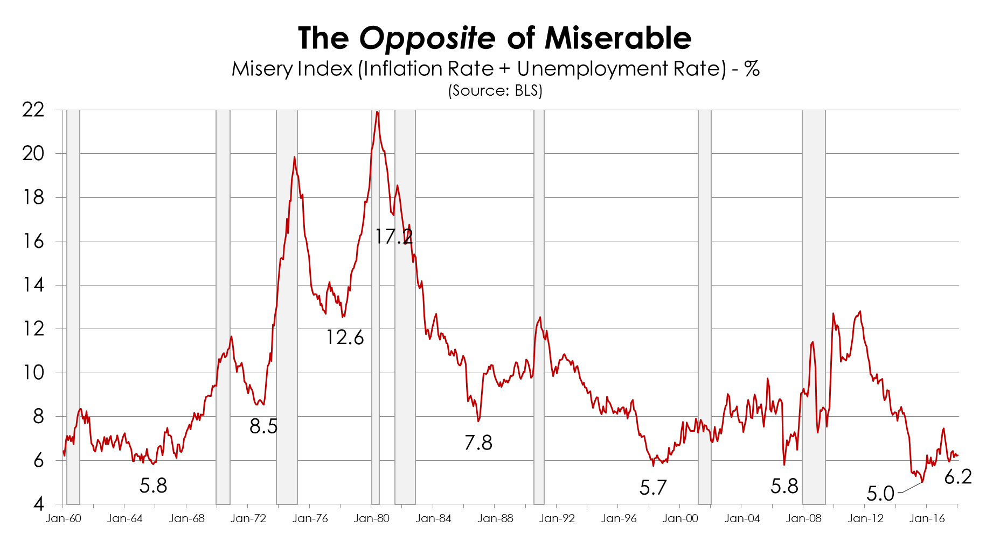

Slide 24
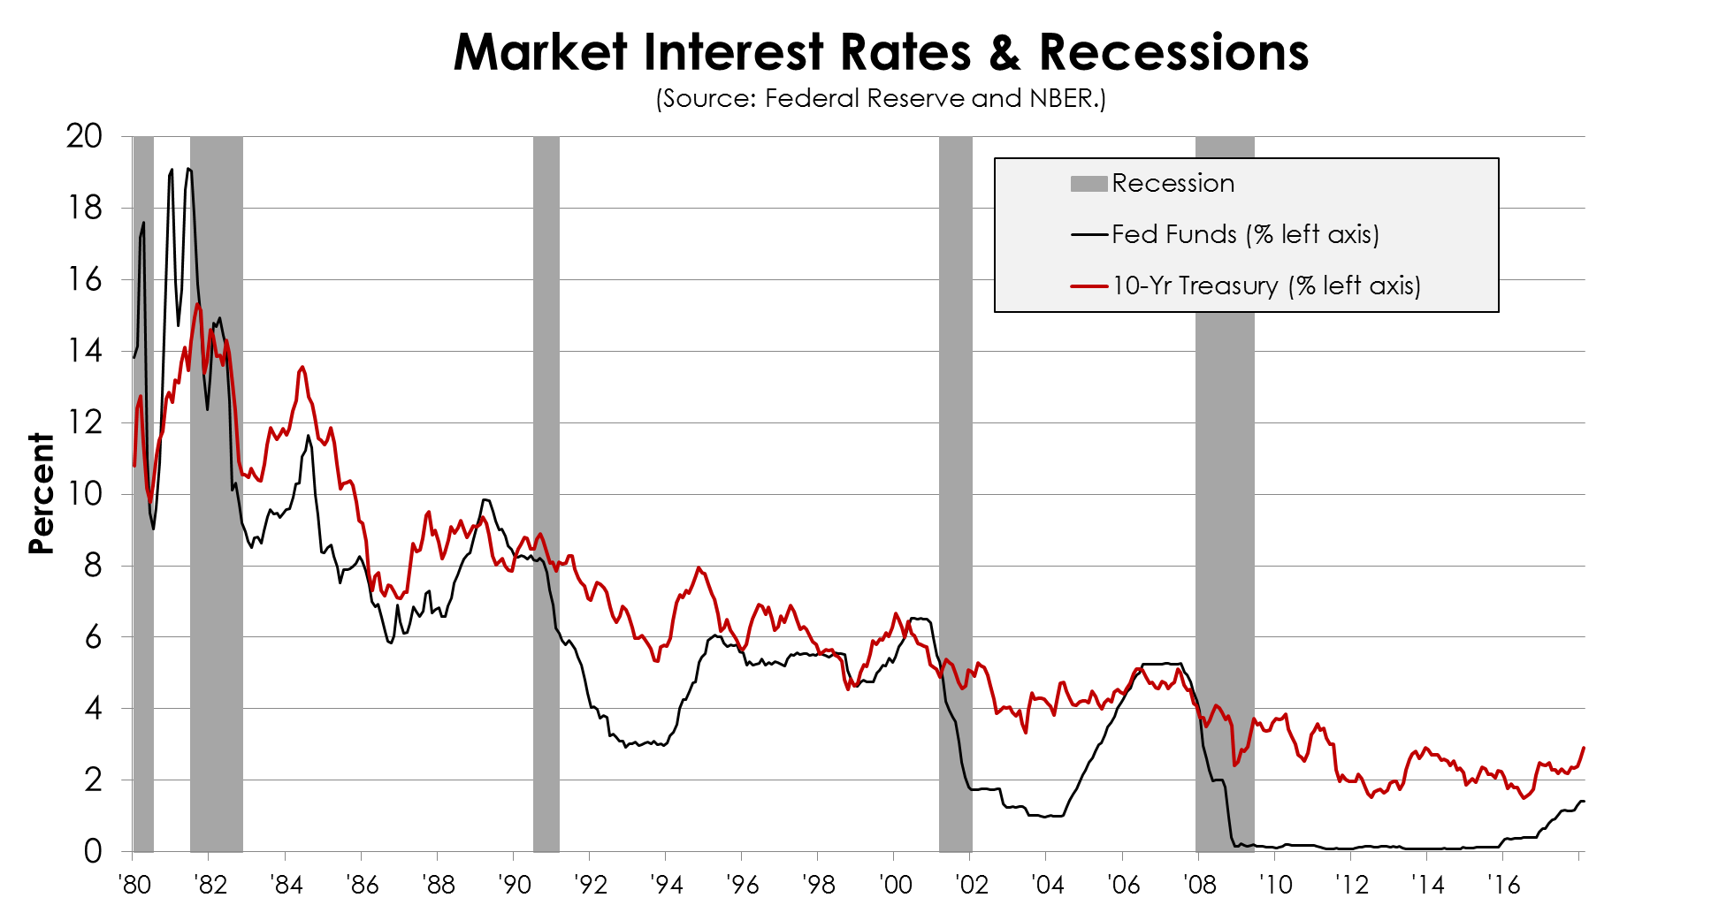
Notes:
But we might be concerned about rising interest rates, right?
Overall declining trend in ROA.
Tends to fall as the spread between short- and long-term rates decreases.
For example, when Fed starts raising rates.
But tends to be gradual.

Slide 25
State of the U.S. Economy
U.S. economy growing at a healthy rate & more to come
Labor markets at full employment
Inflation still tame – but more concern
Consumer finances in great shape overall
A cautious but engaged Federal Reserve
Obvious market volatility

Slide 26
Consumer Sector
Notes:
Jordan:
- Yes, Mike, the economy is doing great, but many average Americans are still struggling.
- Let’s take a look at some figures from the 2016 Federal Reserve Report on Economic Well-Being of U.S. Households.

Slide 27
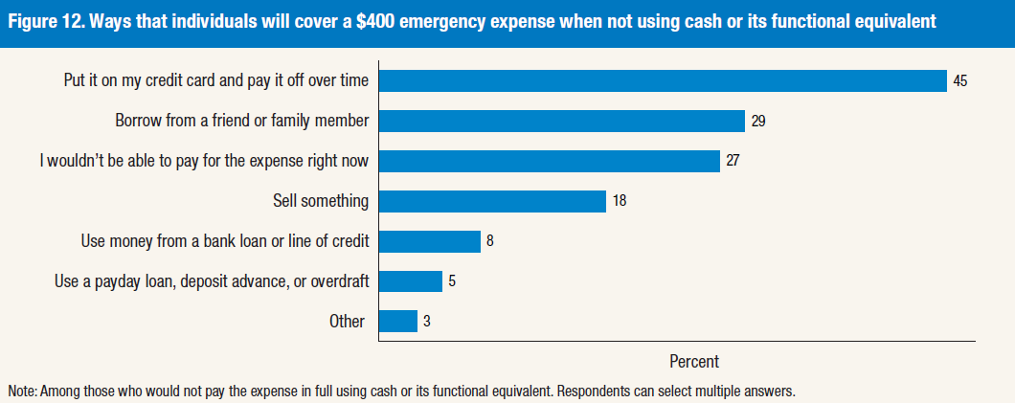
44% of households could not cover $400 emergency expense
Notes:
- 44% of households could not cover a $400 emergency expense.
- Among these, 45% would have to put it on a credit card.
- 29% would borrow from a friend or family member
- 27% say that have no way of paying for the expense right now!

Slide 28
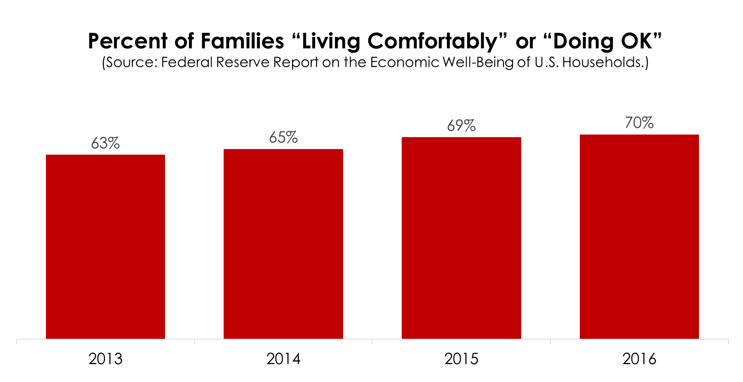
Notes:
- Fortunately, we see some improvement in the percent of families “living comfortably” or “doing okay”: this is good news.
- But this also means there are still 30% that are “just getting by” or “finding it difficult to get by.”

Slide 29
Notes:
*57% said that if they lost their main source of income, they would have no way of covering 3 months of expenses.
- Indicates very little savings.
- Many people in relatively precarious financial situations.

Slide 30
Economic Well Being
30% finding it “difficult to get by” or “just getting by”
44% could not cover a $400 emergency expense
22% juggling two or more jobs
28% have no retirement or pension
Notes:
- These represent millions and millions of Americans that are still struggling financially.

Slide 31
Credit Union Operating Results
Notes:
Mike

Slide 32
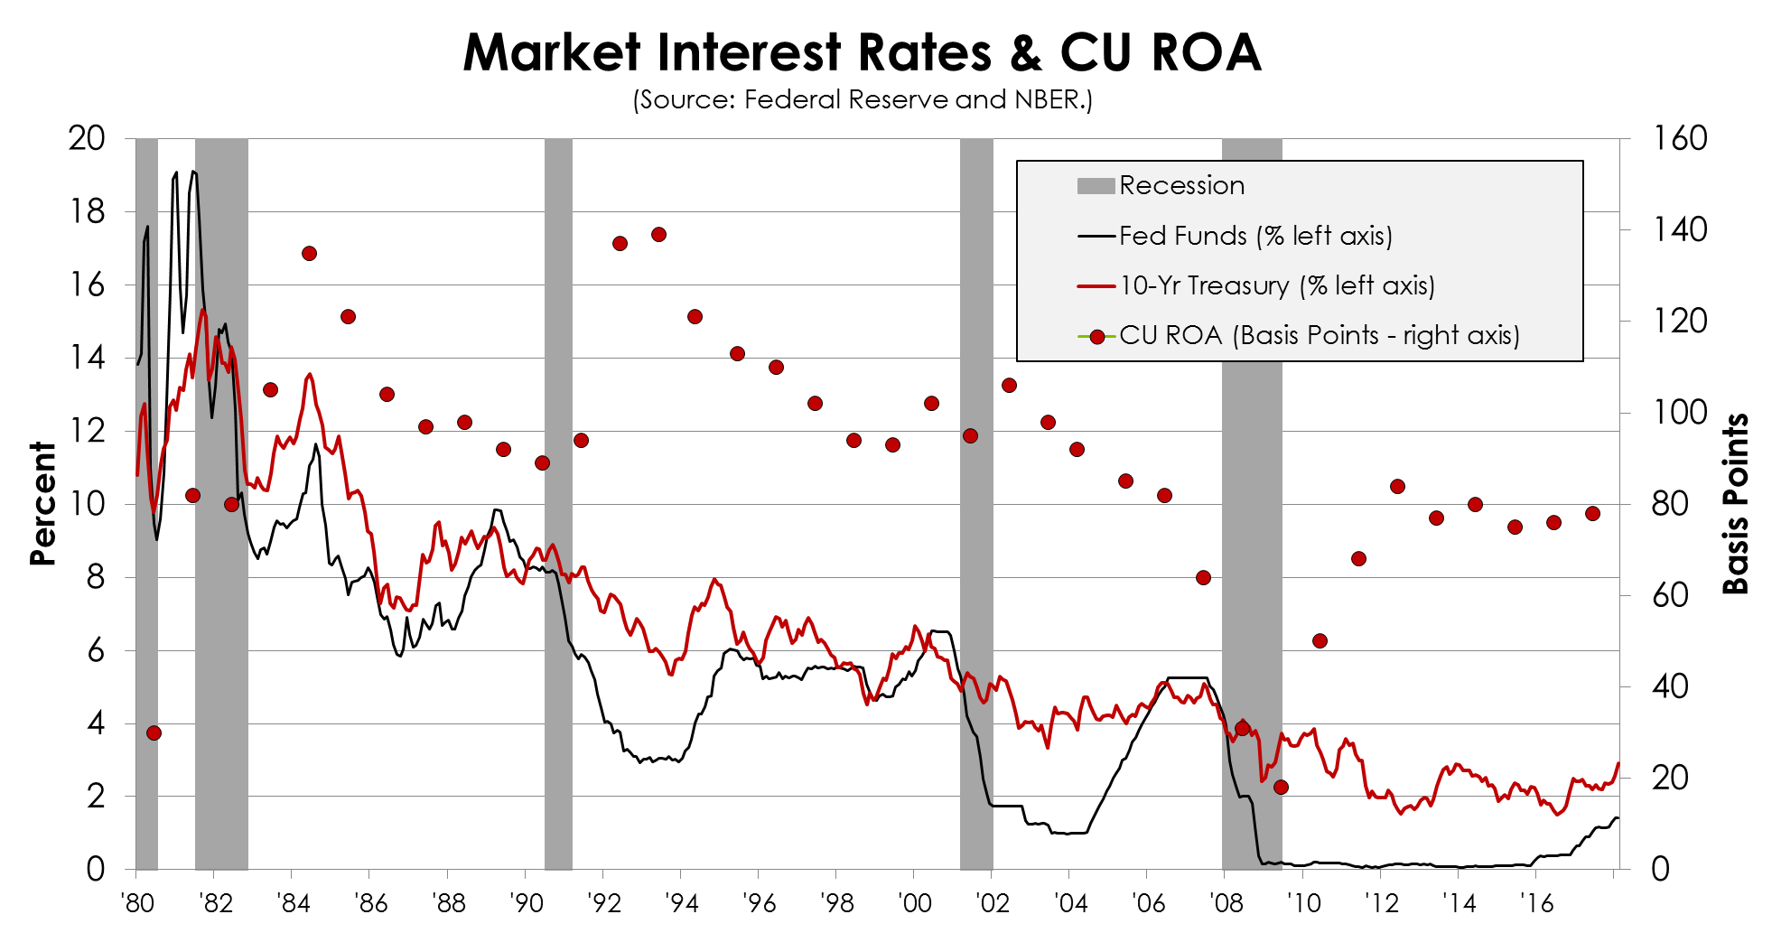
Notes:
But we might be concerned about rising interest rates, right?
Overall declining trend in ROA.
Tends to fall as the spread between short- and long-term rates decreases.
For example, when Fed starts raising rates.
But tends to be gradual.

Slide 33
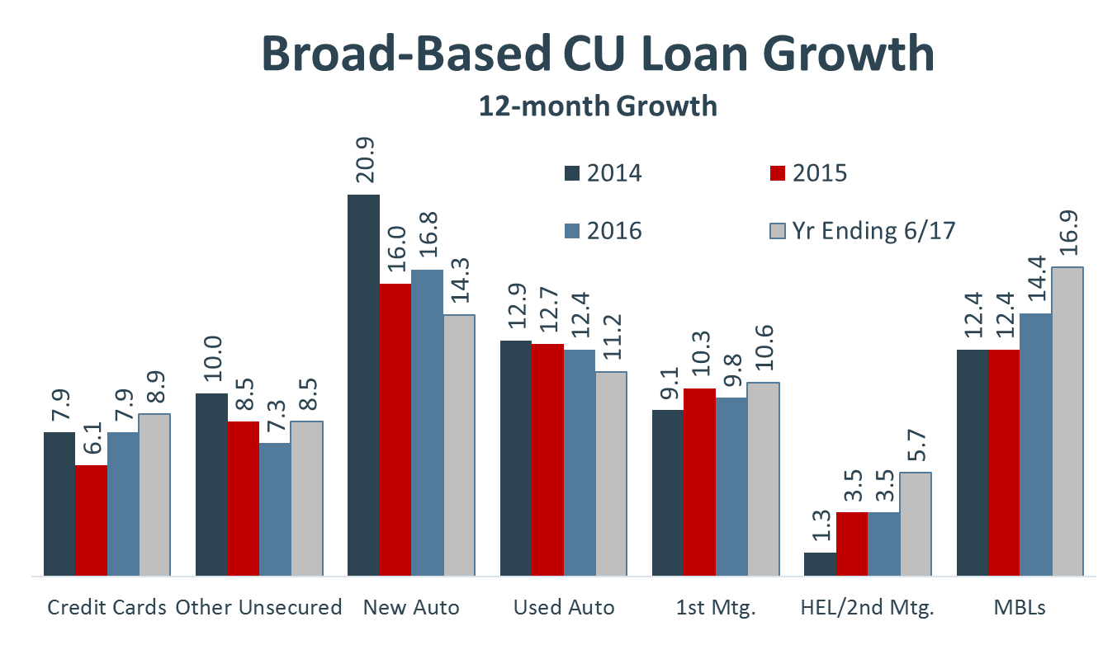

Slide 34
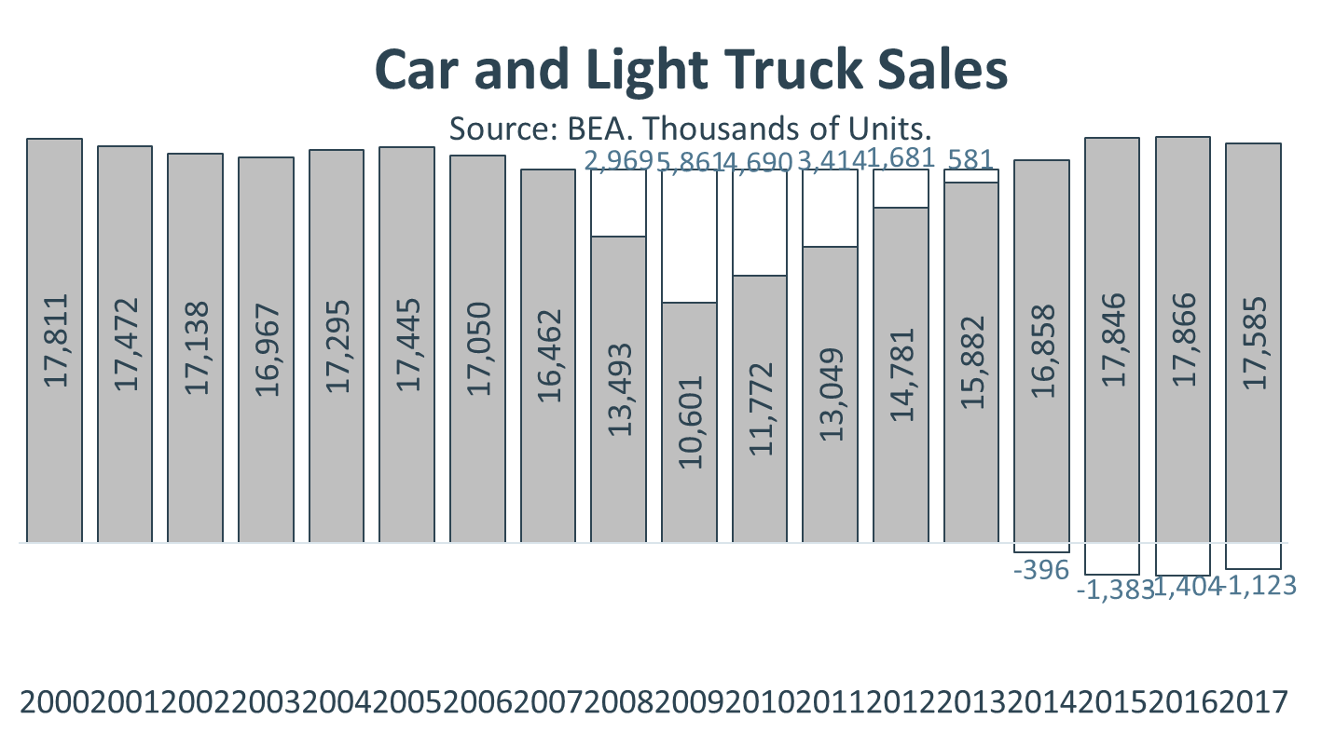
-18.7 Million!
+4.3 Million!

Slide 35
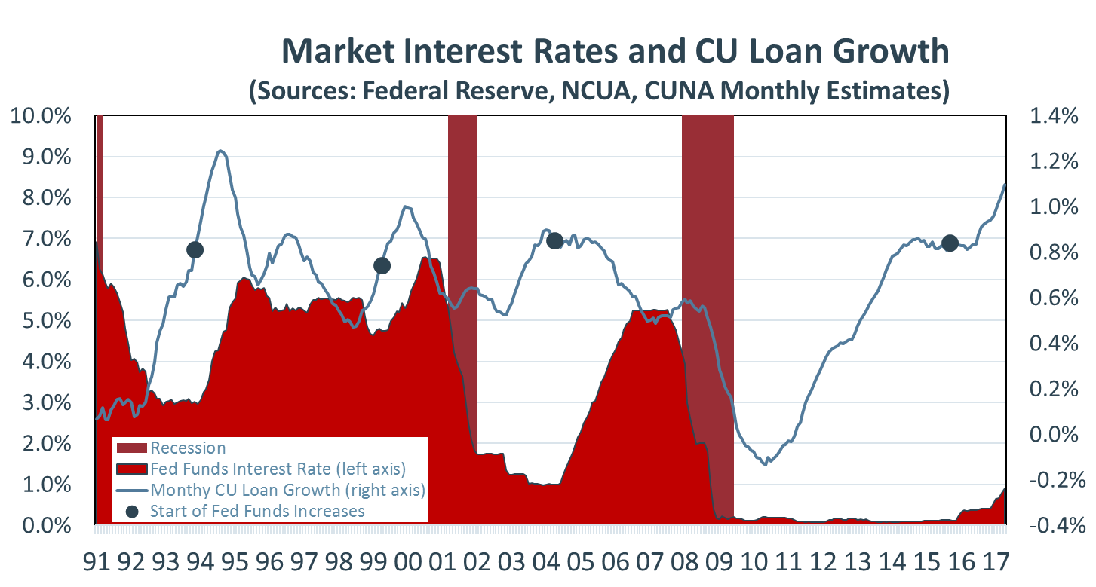
Notes:
If history is a good guide loans should continue to growth at healthy rates despite the Federal Reserves market interest rate increases. Note the black dots on this graphic represent the point at which the Fed started raising the fed funds interest rate (i.e., straight below in the red area of the graphic). In the three previous rate cycles loans growth remained high for 12-15 months (actually accelerating in 2 of the three cases). In each of the previous three cycles the Fed raised rates MUCH more aggressively.

Slide 36
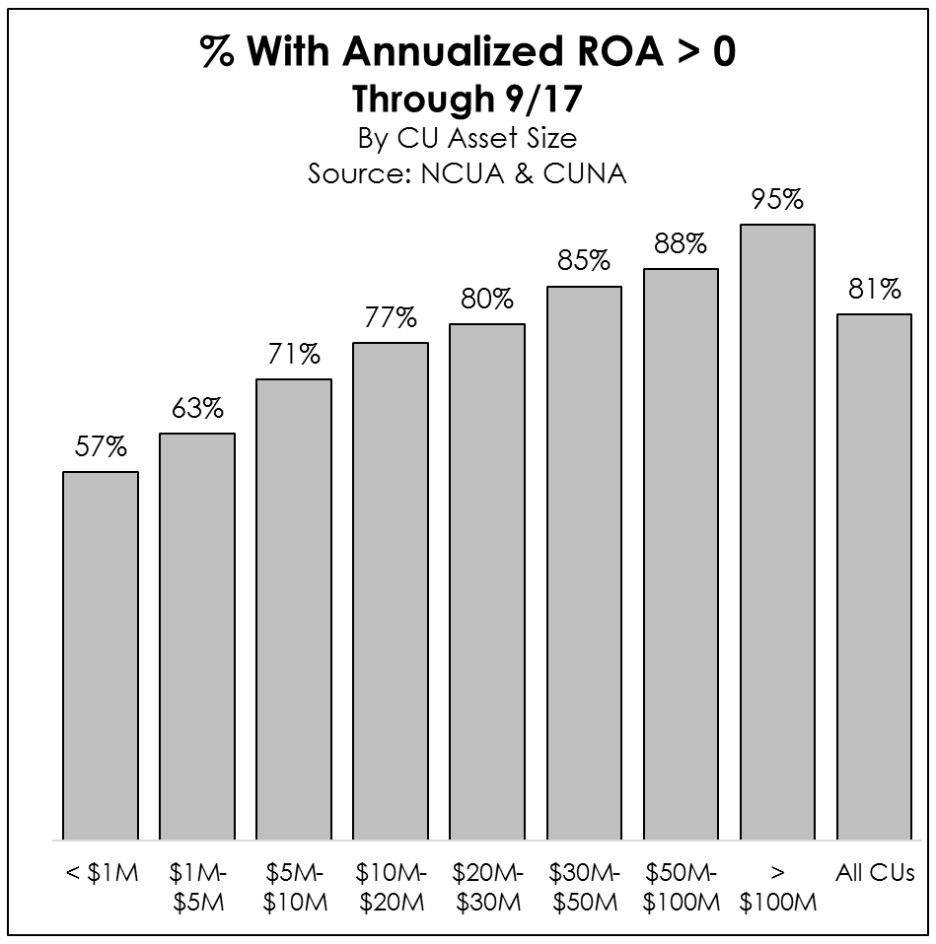
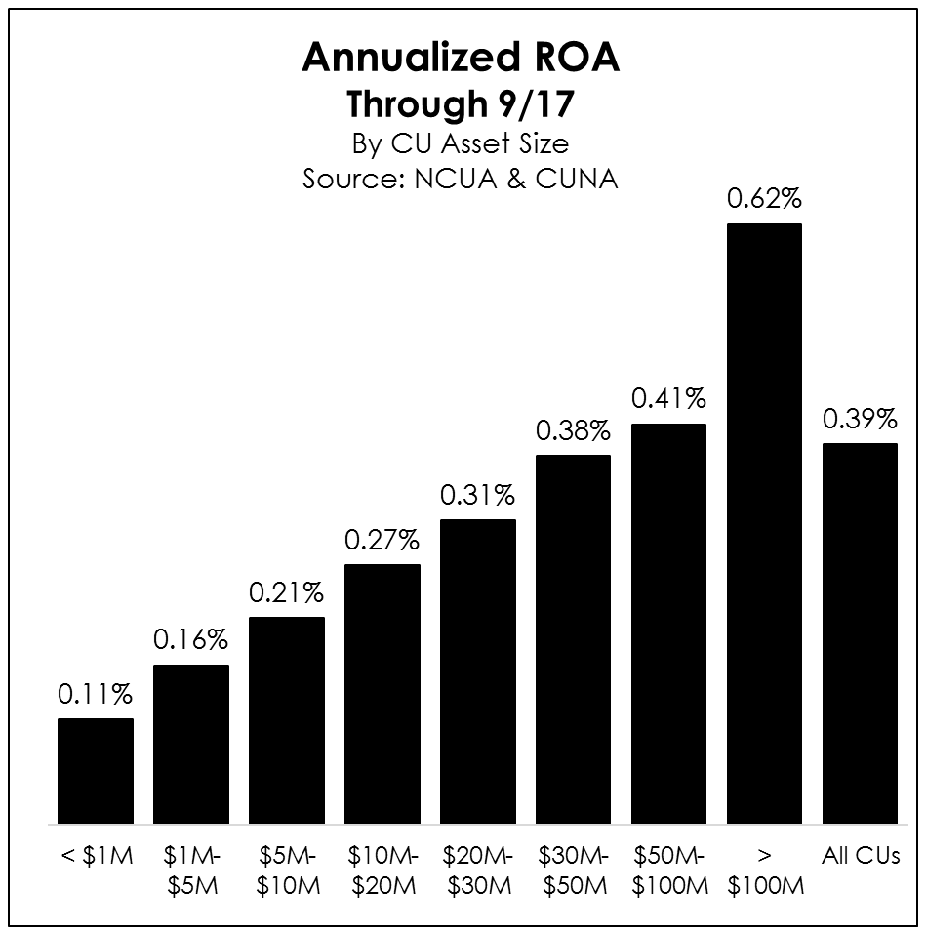
Asset-Weighted ROA = 0.78%

Slide 37
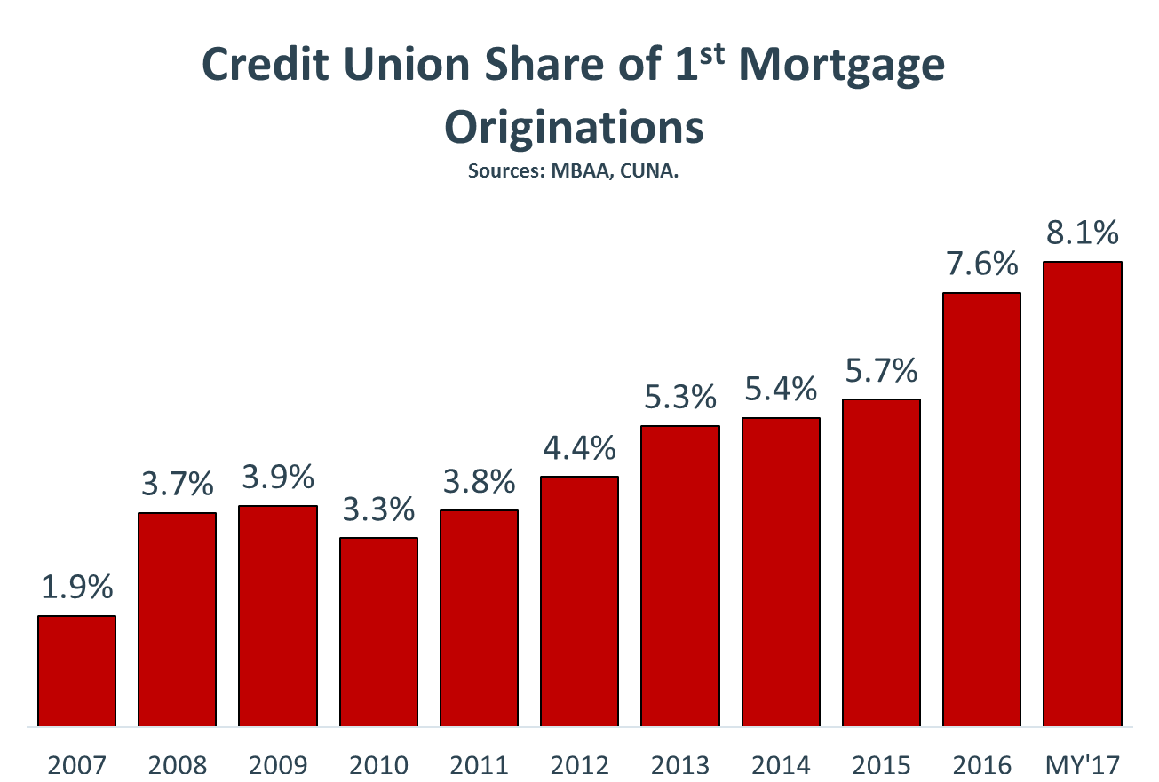

Slide 38
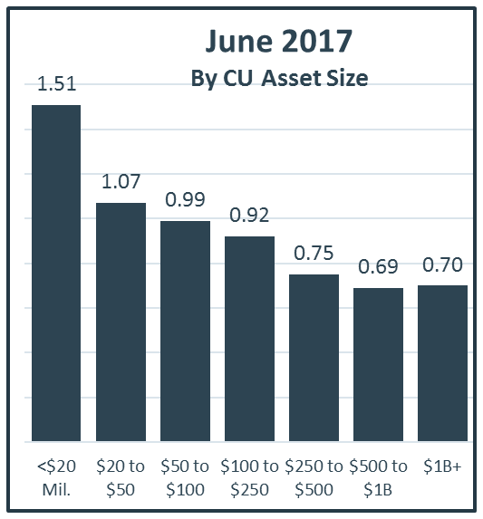
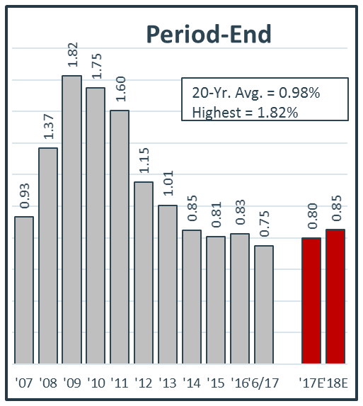
CU Asset Quality: Delinquency
(Percent of Total Loans. Source: NCUA and CUNA)

Slide 39
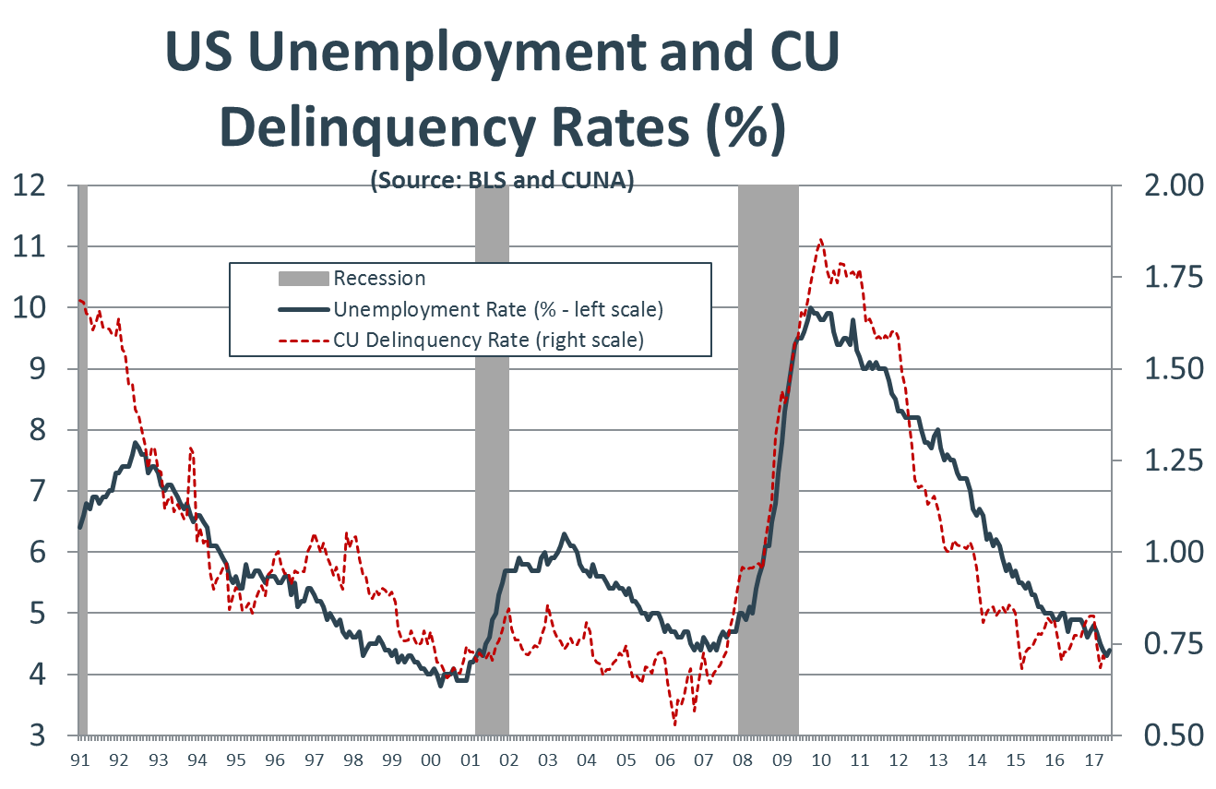

Slide 40
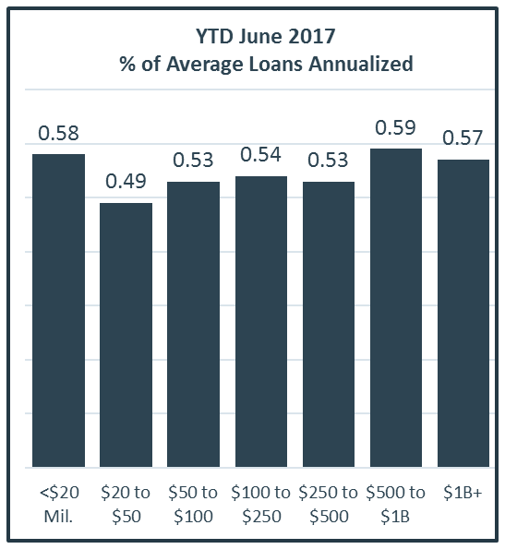
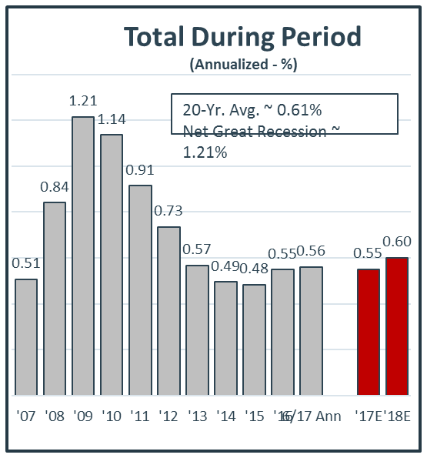
CU Asset Quality: Net Chargeoffs
(As a Percent of Average Loans. Source: NCUA and CUNA)

Slide 41
Regulatory Burden
Notes:
Jordan
- That’s right Mike: the smaller credit unions are struggling.
- And as we’ll see, they’re the ones that face that greatest burden of costly regulations.

Slide 42
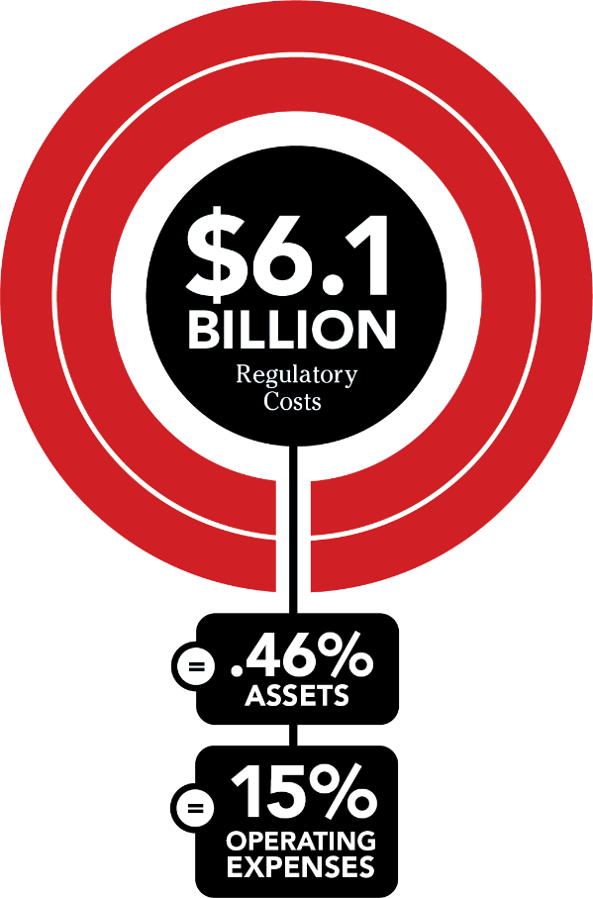

Credit Union Regulatory Costs
*Total costs represent 61% of industry earnings
Notes:
- Update to 2015 study by Cornerstone.
- Survey of 51 credit union across 27 states.
- Improves on previous study by incorporating estimated total cost of each major regulation.
- Total regulatory burden of $6.1 billion, $800 million higher than previous estimate.
- This represents 0.46% in assets and 15% of operating expenses.
- And 61% of industry earnings!

Slide 43
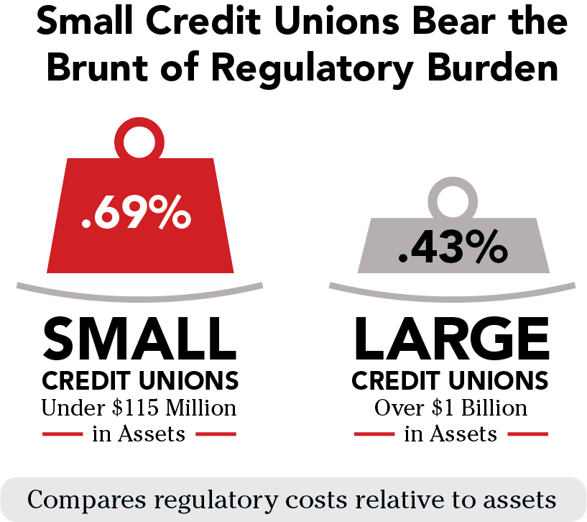
Notes:
- This burden is particularly hard on smaller credit unions:
- 69 basis points versus 43 basis points for large credit unions.
- And many of these small credit unions are not making more than 69 basis points in earnings!
- So, regulations are taking away all or a significant proportion of earnings.
- Even for the larger credit unions, 43 basis points is a huge chunk of their earnings.

Slide 44
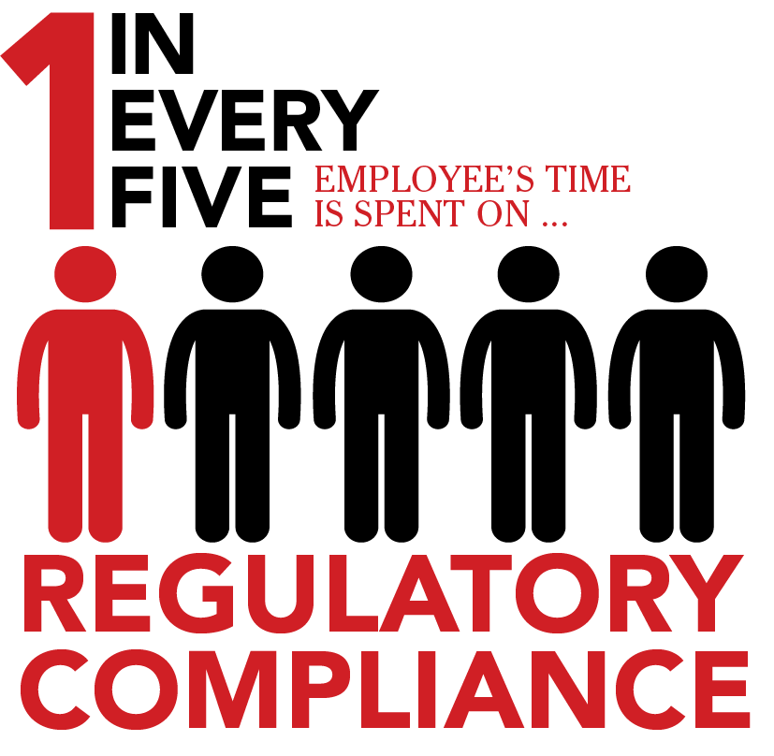
Distribution of $6.1 Billion in Total Costs:
75% are staff costs including risk management, member-facing and support employees.
23% are 3rd party expenses including compliance, technology, legal and training.
2% are depreciation of capitalized expenses including technology investments.
Notes:
- The majority of these costs are staff costs, at 75%.
- Another way of looking at this is that roughly 1 in every 5 staff members are completely dedicated to regulatory compliance.
- Another 23% of regulatory costs are 3rd party expenses, such as compliance, technology, legal and training.

Slide 45
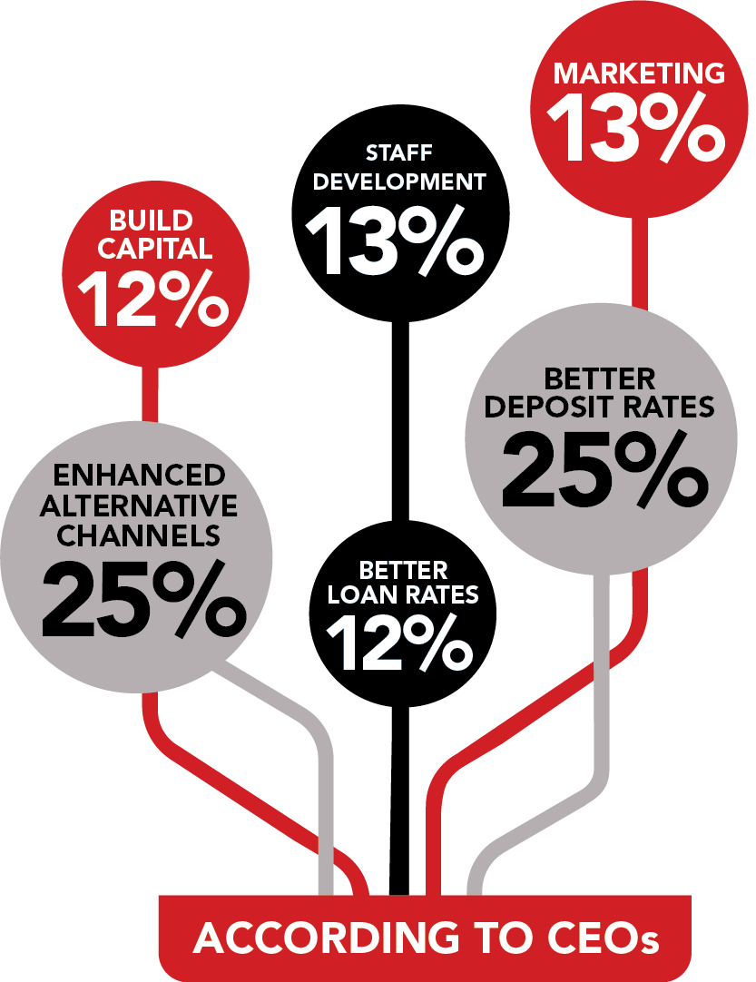
Reduced Regulatory Costs Would be Used to Better Serve More Members
Notes:
- Credit unions could be doing a lot of good with these resources!
- 25% of CEOs said they would use that money to offer better deposit rates.
- 12% would offer better loan rates.
- 25% would offer enhanced alternative channels.

Slide 46
cuna.org/regburden

Slide 47
Recent Events
Legal challenges to ADA demand letters and lawsuits
Legal opinions and rulings related to TCPA
Hatch letter and bank challenges to credit union tax status

Slide 48
What can I do?
Get involved in the credit union movement, starting at the local level
Get to know your elected officials
Become an advocate for credit unions
Our advocacy is strong, but we are under attack

Slide 49
Thank you
Bill Cheney, President/CEO
SchoolsFirst Federal Credit Union
bcheney@schoolsfirstfcu.org

Slide 50
Questions/Comments?

