Slide 1
Portfolio Risk Management
Staying a step ahead
Michael Cochrum
President/CEO
CUBI.Pro

Slide 2
Challenges that collectors face
in almost every credit union.
You are literally the last line of defense
Very little is done to support your role
Most of the damage is done before you get your hands on the account

Slide 3
Risk Management Techniques that
will make every collector smile.
Accurate and Consistent Data Gathering
Regular Account Risk Grading
Predictive modeling of member behavior
Analysis of curing tool effectiveness.

Slide 4
Credit Application, Yes. But keep that info
Proactively Connect with Members on Social Media
Ask for New Information at Every Contact
Store Data in Accessible Format
Data Acquisition

Slide 5
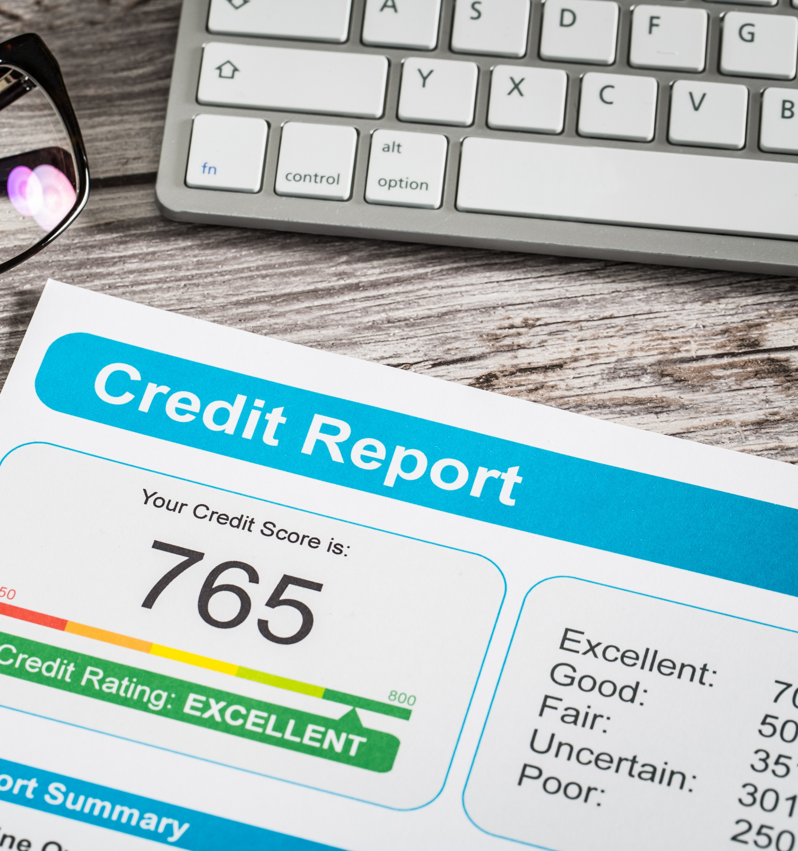
Credit Scores Change Over Time
Update Collateral Values
Re-grade Borrowers Based On Current Risk
Create Strategies Around Changing Risk

Slide 6
Economic changes can impact borrower’s capacity and willingness to pay
If the Credit Score changes, So does the probability of default and loss
Payment behaviors can inform us about future performance, regardless of score
What strategies have the greatest impact on changing behavior

Slide 7
Does the process need to change to yield better results.
Do Borrower’s with Different Characteristics respond differently?
Think of Curing Tools as Products. How Well Do They Work?

Slide 8
Insist on being a part of the
Collections
Lending Feedback Loop

Slide 9
972.814.1477
Michael.Cochrum@CUBI.Pro
linkedin.com/company/cubi-pro
www.CUBI.Pro

