Slide 1
A Litigation Recovery Strategy for the Current Regulatory Environment
Presented By:
Rob Yarmo and Jason Nesbit

Slide 2
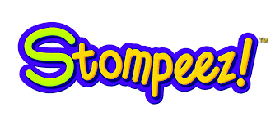
TCPA Class Action Settlement!

Slide 3
Audience Poll
Raise your hand if you are responsible for or have a hand in managing the recovery of losses at your credit union
Keep your hand raised if your credit union has losses that have not been collected
Keep your hand raised if legal recoveries are an integral part of your strategy
Keep your hand raised if you employ a robust legal selection and management process supported by a Compliance Management System

Slide 4
Industry Trends
CFPB developing debt collection rules
Uncertain political climate
Agency and law firms are consolidating
Debt sales and collection agency risk is increasing
Credit Unions under increasing regulatory focus
Shifting attitude in Credit Union space towards legal

Slide 5
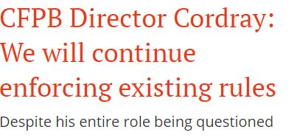
Headlines
---American Banker, Feb 9th, Ohad Samet
---Credit Union Times, Jan 31st David Baumann
---Wall Street Journal, Jan 24th Yuka Hayashi
---The Hill, Feb 17th Adonis Hoffman
Operations Must Focus on Reducing Risk while Improving Results
TCPA suits outpace FDCPA suits – driven by potential damages
Consumers shifting channels away from the telephone: emails, webchat, mobile
Regulatory bodies will be slow to change their course…they will continue to advance their agendas despite potential changes
Where are the opportunities that can lower risk AND improve results?

Slide 6
Revenue Maximization Options
In-House Collections
Outsource to Collection Agency
Low Balance
Early Stage
Late Stage
In-house Legal
Early-Out
Primary
Secondary
Tertiary
Quad
Legal Collections
Debt Sales
Internal
Direct
Forwarders
Managed Model
One-Time
Forward Flow Agreement

Slide 7
Decision Considerations
Challenges
Opportunity vs Risk
Decision
Revenue maximization
Customer/Member loyalty and goodwill
Exposure to regulatory oversight
Judicial/state trends
Possibility of lawsuits or counter-claims… valid or nuisance
Brand/Charter protection
Economic conditions
Cost of infrastructure to maintain various options

Slide 8
Most Effective Model?
Lots of industry ‘noise’ among servicers is normal in an ever-changing economic and regulatory world...new ownership, mergers, closures, change in direction or core management, etc.
It’s not all doom and gloom… well managed agencies and attorneys are adapting to the changing requirements
Considerations:
Do you have the right infrastructure in place to manage administrative needs, recovery expectations, vendor management and compliance oversight?
Can you demonstrate arms length ‘meaningful engagement’ of your service providers? (Vendor Mgmt.)

Slide 9
Most Effective Model?
Most effective strategy combines a solution that delivers the highest net return and mitigates risk
What do you gain or lose with each option? Cost consideration? Economies of Scale? Effectiveness? Specialization of function? Time needed to develop expertise? Control over process and customer experience?
The least effective models are ‘do nothing’ or passive multi-stream only agency placements
The bottom line: The most effective recovery process is one that segments accounts and treats according to the inherent attributes at the account level. It combines:
In-house handling for limited time for sensitive, high value or high risk accounts.
Legal selection at charge off or post prime should be an important part of your recovery strategy along with multi stream agency strategy or debt sale for accounts that don't qualify for legal.

Slide 10
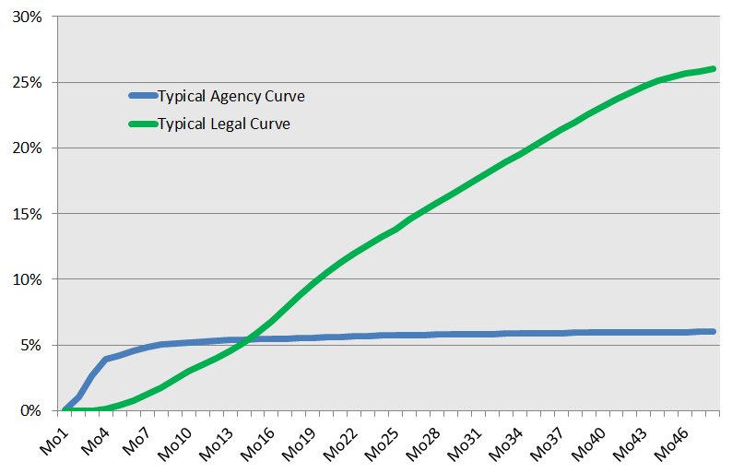
Legal Recovery vs. Agency Recovery Rates
Accounts Qualifying for Legal Recover Up to Five Times Agency at 48 Months!

Slide 11
Why the Legal Process is the most effective method:
Psychological: it is the ‘end of the line’ and a prime motivational tool
Costly to defend and requires time commitment
Most creditors deem judgments on credit bureau reports to be more detrimental when credit decisioning
Can involve involuntary recovery methods- wage/bank garnishment, seizure/sale of property
Delivers historically long recovery curves
Considered less risky than agency or internal cycling
Protects your statute rights!

Slide 12
Benefits of a Robust Legal Channel
Years of data demonstrate that a legal channel will liquidate significantly higher by selecting the right accounts and effective management when compared with control group or BAU models.
What are the considerations in selecting the right accounts?
Data driven decisioning supplements human selection
Age of account (Statute of Limitations)
Balance in consideration of court costs at state/county level
Demographics- state, county and zip
Absence of negative attributes from Recovery Score
Assets confirmed including POE
Right party contact info confirmed
Media availability

Slide 13
Do You Have ALL of the Media/Documents?
Requirements by state vary significantly. To commence legal action you will/may be required to produce the following:
Auto deficiency example:
Pay History or Statement of Account
Contract
Deficiency calculation
Copy of title
Right to Cure letter
Proof of mailing
Repo Bill
NOIS (Notice of Intent to Sell)
Auction Sales Receipt

Slide 14
Do You Have ALL the Media/Documents?
type | STATE | Docs Required | Application | Contract | Pay History | Deficiency Calc | Copy of Title | Right to Cure | Proof of Mailing | Aff of Repo | Repo Bill | Notice of Intent to Sell | Auction Sales Receipt | SOA
AUTO | AK | CTR,SOA |  | CTR |  |  |  |  |  |  |  |  |  | SOA
ADEF | AK | CTR,DFN,RTC |  | CTR |  | DFN |  | RTC
ADDF | AK | CTR,DFN,RTC |  | CTR |  | DFN |  | RTC
LDEF | AK | CTR,DFN,RTC |  | CTR |  | DFN |  | RTC
LEAS | AK | CTR |  | CTR
ADEF | AL | CTR,RTC,NOI,ASR,DFN |  | CTR |  | DFN |  | RTC |  |  |  | NOI | ASR
ADDF | AL | CTR,RTC,NOI,ASR,DFN |  | CTR |  | DFN |  | RTC |  |  |  | NOI | ASR
LDEF | AL | CTR,RTC,NOI,ASR,DFN |  | CTR |  | DFN |  | RTC |  |  |  | NOI | ASR
AUTO | AL | CTR,SOA |  | CTR |  |  |  |  |  |  |  |  |  | SOA
LEAS | AL | CTR |  | CTR
AUTO | AR | CTR,SOA |  | CTR |  |  |  |  |  |  |  |  |  | SOA
LDEF | AR | CTR |  | CTR |  |  |  |  |  |  | RST
ADEF | AR | CTR |  | CTR
ADDF | AR | CTR |  | CTR
LEAS | AR | CTR |  | CTR
AUTO | AZ | CTR,PMH,SOA |  | CTR | PMH |  |  |  |  |  |  |  |  | SOA
LEAS | AZ | CTR,PMH |  | CTR | PMH
ADDF | AZ | CTR,DFN,NOI |  | CTR |  | DFN |  |  |  |  |  | NOI
ADEF | AZ | CTR,DFN,NOI |  | CTR |  | DFN |  |  |  |  |  | NOI
LDEF | AZ | CTR,DFN,NOI |  | CTR |  | DFN |  |  |  |  |  | NOI
AUTO | CA | CTR,SOA |  | CTR |  |  |  |  |  |  |  |  |  | SOA
ADEF | CA | CTR,NOI,DFN |  | CTR |  | DFN |  |  |  |  |  | NOI
ADDF | CA | CTR,NOI,DFN |  | CTR |  | DFN |  |  |  |  |  | NOI
LDEF | CA | CTR,NOI,DFN |  | CTR |  | DFN |  |  |  |  |  | NOI
LEAS | CA | CTR |  | CTR
AUTO | CO | CTR,SOA |  | CTR |  |  |  |  |  |  |  |  |  | SOA
ADEF | CO | CTR,DFN,NOI |  | CTR |  | DFN |  |  |  |  |  | NOI
ADDF | CO | CTR,DFN,NOI |  | CTR |  | DFN |  |  |  |  |  | NOI
LDEF | CO | CTR,DFN,NOI |  | CTR |  | DFN |  |  |  |  |  | NOI
LEAS | CO | CTR |  | CTR

Slide 15
Legal Recovery Channel Options
10
9
8
7
6
5
4
3
2
1
Managed Network Model
Forwarding Attorney
Forwarding Network
RECOVERY
Direct Attorney
Agency
1 2 3 4 5 6 7 8 9 10
RISK MITIGATION

Slide 16
Options For Implementing a Legal Strategy
Agency driven legal program
Direct attorney
Regional attorney
Forwarding attorney
Forwarding company
Managed solution partner

Slide 17
Challenges of a Robust Legal Channel
What does ‘effective management’ mean?
Having full transparency at the portfolio, strategic and account level!
Pre-legal phase
Legal phase pre-suit
Legal phase post suit
Legal phase post judgment

Slide 18
Vendor Oversight & Compliance Requirements
Compliance Management System
Roles & responsibilities
Risk assessment
Vendor Management
Due diligence
Contractual rights
Complaint & Resolution Management
Logging, reporting
Trend tracking
Communication With Consumers
Authentication
Training
Document Management
Retention
Controls
Physical & Data Security
Licensing & Insurance
Firewalls
Surveillance
Training
Employee Screening & Hiring
Fees & Interest
Cost & Payment Handling
Trust Account Review
Litigation Management
Attorney practicing meaningful involvement
Suit decisioning
Recons
Remittances
Consumer refunds
Payment order
Certificates
BAR cards
Background checks
Testing / compensation
Required programs
Verification of test results
Account Work Effort Audit
SLA adherence
Regulatory adherence
Collection Call Evaluations
Required oversight
Remediation & training
Complete and up to date
Defined affiant process

Slide 19
Protect the Charter Against Potential Negative Consequences
Steps necessary to protect from regulatory scrutiny:
Create separate compliance team
Develop comprehensive monthly management process, audit program and gain vendors’ buy-in
Audit program should be modeled on CFPB and CUNA models
Formalize your complaint management process internally and with vendors (timeliness, resolution and trends)
Institute annual audit program, including 1-2 day site visit
Develop affirmative action strategies for non-compliant vendors
Or… Outsource the process to a team of experienced professionals that specialize currently doing the above

Slide 20
Are Both Defect-Free Compliance and Superior Recoveries Possible?
Both goals are certainly attainable if you have committed sufficient resources to either build out an effective infrastructure with experienced auditors (and travel budget!) or hire a highly qualified partner(s) to whom you have outsourced the process
A commitment to either option will ensure that revenue maximization is realized, your brand is protected, you’ve mitigated possible nuisance lawsuits/counter-claims and that you have a competitive edge in your marketplace

Slide 21
Four Take-aways
Don’t even think about litigation unless you can confirm availability of 100% of media/documents
Don’t rely solely on collector selected accounts*
Attorney activity must be managed*
Implement a lock-down CMS*
*CONSIDER OUTSOURCING TO A SPECIALIST

Slide 22
Summary
A well managed legal recovery strategy will net many multiples in incremental recovery
Develop a consistent, disciplined legal account selection process
Set realistic recovery expectations, it’s a long, profitable runway if managed effectively
Develop infrastructure to support and manage attorney activities, track/report results, support compliance OR outsource to a competent partner that has the infrastructure in place
Keep the ‘wolves at bay’ by implementing a proven CMS OR outsourcing the function to a competent partner(s)

Slide 23
This can become a reality!

Slide 24
About Harvest Strategy Group
Exclusive attorney and collection agency management network
Performance management for pre-legal, legal and agency streams in the CU space for 10+ years
ProScore^{tm} Account Selection Model
Robust reporting suite
Compliance management
Full and complete audits of each network partner

Slide 25
Contact Information
Jason Nesbit
jason.nesbit@harveststrategygroup.com
(303) 531-0627
www.harveststrategygroup.com
Rob Yarmo
rob.yarmo@harveststrategygroup.com
(416) 669-5490
www.harveststrategygroup.com

